Slide 1
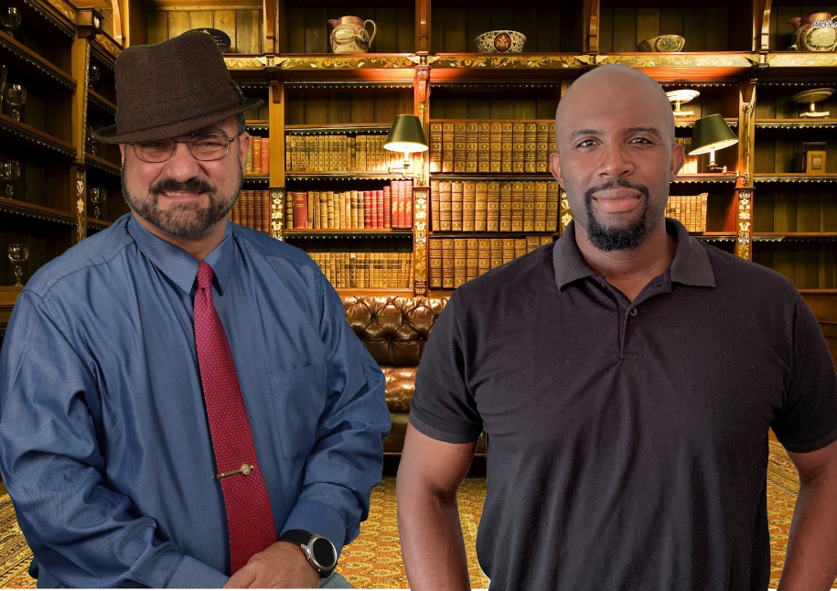
Toss Out Male Tropes: Men are More Than Black and White
Part 3: Characters and Archetypes and Tropes… Oh My!
JP Robinson & Gregg Bridgeman
Notes:
Toss Out Male Tropes!
Men are More than Black & White
Part 3: Characters and Archetypes and Tropes… Oh My!
JP Robinson & Gregg Bridgeman

Slide 2
Successful Christian Self Publishing
http://SuccessfulChristianSelfPublishing.com/MoreThanBW/
This URL will be provided several times.

Slide 3
There are just three conflicts in storytelling.
Man vs. the World
Man vs. Man
Man vs. the Supernatural
Notes:
There are just three conflicts in storytelling. They are
Man vs. the World
Man vs. Man
Man vs. the Supernatural

Slide 4
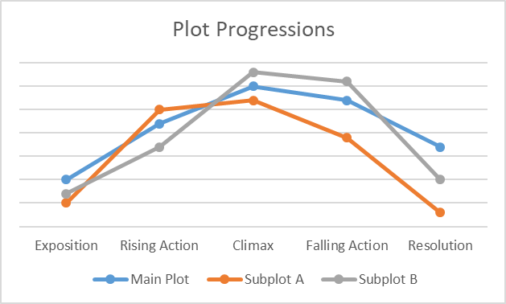
There are just seven basic plots
Overcoming the Monster
Rags to Riches
The Quest
Voyage and Return
Rebirth
Comedy
Tragedy
Some add two more plots
Mystery
Rebellion against “the One”
Notes:
Plots
There are just seven basic plots. Some claim that Rebellion Against “The One” is a plot line. This typically concerns a hero who rebels against the all-powerful entity that controls the world until he is forced to surrender to that power. In some versions, “the One” is portrayed as benevolent, as in the story of Job, while in others “the One” is malevolent, as in 1984, Brazil, or The Hunger Games.
Some claim that Mystery is a plot and define a Mystery plot as a story in which an outsider to some horrendous incident or event (such as a murder) then tries to discover the truth of what happened.
The problem I have with these additions is that they mainly fall into one of the previous seven. For example, what is being investigated in a Mystery is a story based on one of the other plots or the Rebellion against “the One” is an overcoming the Monster plot or a Rebirth plot.
I believe that either of these can fit nicely inside the traditionally recognized seven classical plots.
Overcoming the Monster
Rags to Riches
The Quest
Voyage and Return
Rebirth
Comedy
Tragedy

Slide 5
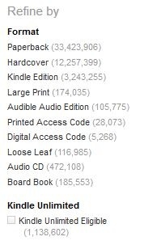
Amazon offered
33 MILLION +
Paperbacks
5 years ago
A call to Amazon in April 2019 resulted in the answer: “…more than 42 million new paperbacks written in English but the number changes daily…”
Notes:
Amazon is the largest book seller in the world. So, we can gauge what the market looks like through them. A call to Amazon in April 2019 resulted in the answer: “…more than 42 million new paperbacks written in English but the number changes daily…”

Slide 6
What Makes Your Story Great?
Notes:
What Makes Your Story Great?
So, with 7 basic plots, 3 basic conflicts, and tens of millions of books currently on sale, how does your once upon a time, something happened to some people and then they did this and that happened and the end stand out among the millions of books out there?

Slide 7
Characterization
Notes:
True to Life 3D Characters
Great Characterization. What a reader is seeking when they pick up a fiction book is a character with which they can relate.

Slide 8
Characters
“My last name is Poirot, like Agatha Christie's famous detective Hercule Poirot; no relation to the fictional character.” ― Ken Poirot
3-D Characters
http://SuccessfulChristianSelfPublishing.com/MoreThanBW/
Notes:
Three-D Characters
“My last name is Poirot, like Agatha Christie's famous detective Hercule Poirot; no relation to the fictional character.” ― Ken Poirot

Slide 9
Characterization is the Key
Three Dimensional Characters are the key to any great book
Great books are character driven books
Exact plot points and dialogue can be forgotten but great characters are memorable
Notes:
Characterization is the Key
Three Dimensional Characters are the key to any great book.
Great books are character driven books.
Exact plot points and dialogue can be forgotten but great characters are memorable

Slide 10
3 Spheres of Characterization
Physical
Material
Intellectual
Learn/Teach
Spiritual
Emotional
Notes:
For the next little while, we’re going to talk about craft. And, this is key.
I realize this is step 1, but if you take only one thing from this class, my prayer is that you take this.
There are 3 Spheres of Characterization:
Physical/Material
Intellectual/Learn/Teach
Spiritual/Emotional

Slide 11
Prop Character
The bellhop took our bags.
The “bellhop” is unformed and unfilled with no description and no dialogue. He or she may as well be a luggage cart.
Notes:
The PROP character
The bellhop took our bags.
The “bellhop” is unformed and unfilled with no description and no dialogue. He or she may as well be a luggage cart.

Slide 12
One Dimensional Character
The blue uniformed bellhop took our bags.
Physical
The “bellhop” is no longer unformed, he or she is uniformed and we have a vague idea of his or her physical appearance.
Notes:
One Dimensional Character
The blue uniformed bellhop took our bags.
The “bellhop” is no longer unformed, he or she is uniformed and we have a vague idea of his or her physical appearance.

Slide 13
Two Dimensional Character
The blue uniformed bellhop put on a practiced smile before he asked, “First time here, I take it?”
Physical
Intellectual
Notes:
Two-Dimensional Character
The blue uniformed bellhop put on a practiced smile before he asked, “First time here, I take it?”
Physical Sphere
Intellectual Sphere
The “bellhop” is no longer one dimensional. He is uniformed and smiles. In addition, he speaks with an interrogative, so we have a vague idea of his powers of observation.

Slide 14
Balanced 3 Dimensional Character
Physical
Intellectual
Characterization inside a balanced story
Spiritual
Notes:
Balanced 3 Dimensional Character
The spiritual sphere is there intentionally because it is the foundation. It’s the building block of the other two spheres.
On the table in front of you, please find colored notecards. Think of one thing that makes up the physical attributes of a character and write that on the yellow card. This can be anything from location to description to battle wounds to attraction to the opposite sex.
If you have a pink card, think of one thing that makes up an intellectual side of a character. This can be education, mental illness, thought processes, intelligence.
If you have a green card, think of one thing that makes up the spiritual part of a character. This can be anything from religious preference to belief in a deity to holiday observances.

Slide 15
The Hunger Games Metaphor
Physical
Intellectual
Spiritual
Notes:
The Hunger Games Metaphor
The Hunger Games series of books completely lacked any spirituality.
Physical/Material
Intellectual/Learn/Teach
Spiritual/Emotional

Slide 16
Mainstream Secular Romance
Physical
Intellectual
Spiritual
Notes:
Mainstream Secular Romance
Mainstream Secular Romance lacks genuine emotion and spirituality and overemphasizes physicality.
Physical/Material
Intellectual/Learn/Teach
Spiritual/Emotional

Slide 17
Traditional Christian Romance
Physical
Intellectual
Spiritual
Notes:
Traditional Christian Romance
Traditional Christian Romance lacks genuine physicality and overemphasizes emotion and spirituality.
Physical/Material
Intellectual/Learn/Teach
Spiritual/Emotional

Slide 18
The Goal
Physical
Intellectual
Spiritual
Notes:
Having a 3-dimensional character makes the character relatable and memorable to the reader.
Note that the Spiritual sphere is the foundation of any 3-D character.

Slide 19
Archetypes
“[T]he hero and the heroine overcome their problems not with social engineering and not with psychology, but with core heroic virtues and they’re always the same. It’s courage, determination, a sense of honor, integrity, and the ability to love, and that’s at the core of all our heroic archetypes.”
-Jayne Ann Krentz
Stock Characters
http://SuccessfulChristianSelfPublishing.com/MoreThanBW/
Notes:
Archetypes are “stock” characters. They are essentially caricatures of characters.
“[T]he hero and the heroine overcome their problems not with social engineering and not with psychology, but with core heroic virtues and they’re always the same. It’s courage, determination, a sense of honor, integrity, and the ability to love, and that’s at the core of all our heroic archetypes.”
-Jayne Ann Krentz

Slide 20
104 Archetypes & Stock Characters
Absent-Minded Professor—An absent-minded scientific genius (Example: Doc Brown from Back to the Future)
All Loving Hero—A character who loves everyone and will suffer for the sins of his or her loved ones.
Anti-Hero—A hero who is driven by pursuit for power, sex, money, control, or particular vices and—because of this—often selfish, anti-social, power-hungry, and materialistic. But these types sometimes showcase some heart in the end (Example: Scarlett O’Hara from Gone with the Wind)
Anthropomorphic Personification—The living embodiment of a fundamental abstraction. They may be god-like in power, but have a much narrower focus and struggle with limits based on what they represent (Example: Joy, Sadness, Fear, Anger, and Disgust from Inside Out)
Audience Surrogate—Characters who the audience sympathize with by actively seeing themselves as them. Usually victims of social challenges (Example: Bella Swan from Twilight)
Notes:
Listing 104 Archetypes
Absent-Minded Professor—An absent-minded scientific genius (Example: Doc Brown from Back to the Future)
All Loving Hero—A character who loves everyone and will suffer for the sins of his or her loved ones.
Anti-Hero—A hero who is driven by pursuit for power, sex, money, control, or particular vices and—because of this—often selfish, anti-social, power-hungry, and materialistic. But these types sometimes showcase some heart in the end (Example: Scarlett O’Hara from Gone with the Wind)
Anthropomorphic Personification—The living embodiment of a fundamental abstraction. They may be god-like in power, but have a much narrower focus and struggle with limits based on what they represent (Example: Joy, Sadness, Fear, Anger, and Disgust from Inside Out)
Audience Surrogate—Characters who the audience sympathize with by actively seeing themselves as them. Usually victims of social challenges (Example: Bella Swan from Twilight)

Slide 21
104 Archetypes & Stock Characters
Bad Boy—A macho loner that doesn’t care that he’s bad. He’s actually proud of it and that often attracts others (Example: Dallas from The Outsiders)
Big Fun—The big, fun, lovable guy or girl (Example: Hurley from Lost)
Black Knight—An evil fighter or antagonist (Example: Darth Vader from Star Wars)
Blind Seer—Characters with a sacrifice of sight that has greater cosmic knowledge (Example: Chirrut from Rogue One)
Boss—The boss of everyone. They are usually controlling, competitive, stubborn, aggressive, and always call the shots
Boy Next Door—The average nice guy that does everything in the right. Clean, wholesome, patriotic, and loves mom, apple pie, and baseball.
Career Criminal—This character devotes his life to committing high stakes crime and is often smart and highly skilled (Example: Al Capone from The Untouchables, most career politicians in real life)
Notes:
Listing 104 Archetypes
Bad Boy—A macho loner that doesn’t care that he’s bad. He’s actually proud of it and that often attracts others (Example: Dallas from The Outsiders)
Big Fun—The big, fun, lovable guy or girl (Example: Hurley from Lost)
Black Knight—An evil fighter or antagonist (Example: Darth Vader from Star Wars)
Blind Seer—Characters with a sacrifice of sight that has greater cosmic knowledge (Example: Chirrut from Rogue One)
Boss—The boss of everyone. They are usually controlling, competitive, stubborn, aggressive, and always call the shots
Boy Next Door—The average nice guy that does everything in the right. Clean, wholesome, patriotic, and loves mom, apple pie, and baseball.
Career Criminal—This character devotes his life to committing high stakes crime and is often smart and highly skilled (Example: Al Capone from The Untouchables, most career politicians in real life)

Slide 22
104 Archetypes & Stock Characters
Champion—The character who is devoted to the cause/life/honor of one character and everything that they entail (Example: Sam from The Lord of the Rings)
Child—First suggested by psychologist Carl Jung, in more recent years, author Caroline Myss has suggested that the child, out of the four survival archetypes (victim, prostitute, and saboteur), is present in all humans This character is young in age or spirit, and loves adventure. (Example: Linus van Pelt from Peanuts, Tommy Pickles from Rugrats, and Peter from Peter Pan)
Chosen One—They have been chosen by someone or some force and are the only ones capable of resolving the plot (Example: Neo from The Matrix)
Chooser of the Chosen One—This is the character who finds and chooses The Chosen One (Example: Morpheus from The Matrix)
Conscience—A classic character type whose sole purpose is to act as the hero’s conscience and moral compass (Example: Jiminy Cricket from Pinocchio, Clarence from It’s a Wonderful Life)
Notes:
Listing 104 Archetypes
Champion—The character who is devoted to the cause/life/honor of one character and everything that they entail (Example: Sam from The Lord of the Rings)
Child—First suggested by psychologist Carl Jung, in more recent years, author Caroline Myss has suggested that the child, out of the four survival archetypes (victim, prostitute, and saboteur), is present in all humans This character is young in age or spirit, and loves adventure. (Example: Linus van Pelt from Peanuts, Tommy Pickles from Rugrats, and Peter from Peter Pan)
Chosen One—They have been chosen by someone or some force and are the only ones capable of resolving the plot (Example: Neo from The Matrix)
Chooser of the Chosen One—This is the character who finds and chooses The Chosen One (Example: Morpheus from The Matrix)
Conscience—A classic character type whose sole purpose is to act as the hero’s conscience and moral compass (Example: Jiminy Cricket from Pinocchio, Clarence from It’s a Wonderful Life)

Slide 23
104 Archetypes & Stock Characters
Contender—A competitive underdog (Example: Rocky from Rocky, Daniel from The Karate Kid)
Corrupter(aka the Saboteur)—Their primary role in the story is to bring out the worst in everyone (Example: Rumpelstiltskin in Once Upon a Time)
Damsel in Distress—A noble and innocent woman in need of rescue (Example: Kim in Taken, Lois Lane in Superman)
Dark Lord—The near-immortal personification of evil (Example: Sauron from The Lord of the Rings)
Dumb Muscle—This character lacks intelligence, or fails to showcase it, and is tasked with doing the heavy lifting of the villain or any antagonist
Elderly Master—A wise, powerful man or woman teaching their powerful craft to a young student (Example: Mr. Miyagi from The Karate Kid)
Notes:
Listing 104 Archetypes
Contender—A competitive underdog (Example: Rocky from Rocky, Daniel from The Karate Kid)
Corrupter(aka the Saboteur)—Their primary role in the story is to bring out the worst in everyone (Example: Rumpelstiltskin in Once Upon a Time)
Damsel in Distress—A noble and innocent woman in need of rescue (Example: Kim in Taken, Lois Lane in Superman)
Dark Lord—The near-immortal personification of evil (Example: Sauron from The Lord of the Rings)
Dumb Muscle—This character lacks intelligence, or fails to showcase it, and is tasked with doing the heavy lifting of the villain or any antagonist
Elderly Master—A wise, powerful man or woman teaching their powerful craft to a young student (Example: Mr. Miyagi from The Karate Kid)

Slide 24
104 Archetypes & Stock Characters
Egomaniac (aka Narcissist)—They like to be the center of attention and usually are often very insecure, overcompensating for a deep need to be loved and/or revered.
Fall Guy (aka Scapegoat)—The innocent to whom the powerful or empowered assign blame
Father Figure—The man who showcases authority, yet has a pure heart and will do all he can to protect those he loves and watches over, either physically or emotionally (Example: Atticus from To Kill a Mockingbird)
Femme Fatale—A beautiful but mischievous and traitorous woman (Example: Selina Kyle aka Catwoman in Batman)
Ferryman—A character that acts as a guide or aid, allowing characters to travel over near impossible obstacles to reach specific destinations (Example: Heimdall from Thor)
Final girl—The “last girl standing” in a horror movie (Example: Laurie from Halloween)
Notes:
Listing 104 Archetypes
Egomaniac (aka Narcissist)—They like to be the center of attention and usually are often very insecure, overcompensating for a deep need to be loved and/or revered.
Fall Guy (aka Scapegoat)—The innocent to whom the powerful or empowered assign blame
Father Figure—The man who showcases authority, yet has a pure heart and will do all he can to protect those he loves and watches over, either physically or emotionally (Example: Atticus from To Kill a Mockingbird)
Femme Fatale—A beautiful but mischievous and traitorous woman (Example: Selina Kyle aka Catwoman in Batman)
Ferryman—A character that acts as a guide or aid, allowing characters to travel over near impossible obstacles to reach specific destinations (Example: Heimdall from Thor)
Final girl—The “last girl standing” in a horror movie (Example: Laurie from Halloween)

Slide 25
104 Archetypes & Stock Characters
Gentle Giant—Big, strong, and intimidating, but they’ve got a heart of gold. (Example: Fezzik from The Princess Bride)
Gentleman Thief—A very charming, sophisticated, and well-mannered thief (Example: Thomas Crown from The Thomas Crown Affair, Neal Caffrey from White Collar)
Girl Next Door—An average but attractive girl with a wholesome quality to her. She is nurturing and forgiving and loves mom, apple pie, and baseball players.
God/Goddess—All powerful but often showcase human qualities in the end (Example: Zeus from The Little Mermaid)
Good King (aka the King)—He is honorable, virtuous, wise, and understanding. He cares about his subjects no matter how seemingly unimportant they are and puts their well-being above his own (Example: King Arthur from Excalibur)
Grande Dame—A very flamboyant woman, often used as a stereotype for an elderly high society socialite (Example: Melanie [Olivia de Havilland] in Gone with the Wind)
Notes:
Listing 104 Archetypes
Gentle Giant—Big, strong, and intimidating, but they’ve got a heart of gold. (Example: Fezzik from The Princess Bride)
Gentleman Thief—A very charming, sophisticated, and well-mannered thief (Example: Thomas Crown from The Thomas Crown Affair, Neal Caffrey from White Collar)
Girl Next Door—An average but attractive girl with a wholesome quality to her. She is nurturing and forgiving and loves mom, apple pie, and baseball players.
God/Goddess—All powerful but often showcase human qualities in the end (Example: Zeus from The Little Mermaid)
Good King (aka the King)—He is honorable, virtuous, wise, and understanding. He cares about his subjects no matter how seemingly unimportant they are and puts their well-being above his own (Example: King Arthur from Excalibur)
Grande Dame—A very flamboyant woman, often used as a stereotype for an elderly high society socialite (Example: Melanie [Olivia de Havilland] in Gone with the Wind)

Slide 26
104 Archetypes & Stock Characters
Grotesque—An often tragic character that induces both fear and pity because bodily deformities overshadow a perfectly normal and likable personality (Example: August Pullman from Wonder, the unnamed Hunchback from The Hunchback of Notre Dame)
Harlequin (aka the Idiot)—A clown or professional fool (Lt. Frank Drebin [Leslie Nielsen] from The Naked Gun)
Herald—This character sets the Hero/Protagonist on the path of adventure (Example: Obi-Wan Kenobi from Star Wars)
Hero—The character that faces the most direct danger and conflict as a basis for the central aspect of the story
Hotshot—This character is often skilled, but reckless, known for taking risks (Example: Maverick from Top Gun)
Hunter of Monsters—A character whose sole mission is to eliminate whatever monster(s) in question (Example: Quinn from Jaws, Beauwulf)
Notes:
Listing 104 Archetypes
Grotesque—An often tragic character that induces both fear and pity because bodily deformities overshadow a perfectly normal and likable personality (Example: August Pullman from Wonder, the unnamed Hunchback from The Hunchback of Notre Dame)
Harlequin (aka the Idiot)—A clown or professional fool (Lt. Frank Drebin [Leslie Nielsen] from The Naked Gun)
Herald—This character sets the Hero/Protagonist on the path of adventure (Example: Obi-Wan Kenobi from Star Wars)
Hero—The character that faces the most direct danger and conflict as a basis for the central aspect of the story
Hotshot—This character is often skilled, but reckless, known for taking risks (Example: Maverick from Top Gun)
Hunter of Monsters—A character whose sole mission is to eliminate whatever monster(s) in question (Example: Quinn from Jaws, Beauwulf)

Slide 27
104 Archetypes & Stock Characters
Ingenue—A young woman who is endearingly innocent and wholesome (Example: Ali Mills [Elisabeth Shue] in The Karate Kid)
Imposter (aka the Pretender)—They are intelligent and take advantage of situations and characters
Jester—They are always lighthearted and joking but always pure of heart and truly caring for others (Example: Will Ferrell in Elf)
Jock—A male athlete who is often muscular, but not very smart
Kirk—The Kirk is a captain or a similar leader who needs to be practical rather than emotional or distant, often having to make decisions in the middle of The Spock or The McCoy (Example: “Jim” James Tiberius Kirk from Star Trek)
Knight-errant—A noble Knight on a Quest
Loner—The Loner isolates him or herself and often struggles to connect with others. They feel alien to others around them (Example: Jim from Rebel Without a Cause)
Notes:
Listing 104 Archetypes
Ingenue—A young woman who is endearingly innocent and wholesome (Example: Ali Mills [Elisabeth Shue] in The Karate Kid)
Imposter (aka the Pretender)—They are intelligent and take advantage of situations and characters
Jester—They are always lighthearted and joking but always pure of heart and truly caring for others (Example: Will Ferrell in Elf)
Jock—A male athlete who is often muscular, but not very smart
Kirk—The Kirk is a captain or a similar leader who needs to be practical rather than emotional or distant, often having to make decisions in the middle of The Spock or The McCoy (Example: “Jim” James Tiberius Kirk from Star Trek)
Knight-errant—A noble Knight on a Quest
Loner—The Loner isolates him or herself and often struggles to connect with others. They feel alien to others around them (Example: Jim from Rebel Without a Cause)

Slide 28
104 Archetypes & Stock Characters
Loser—They don’t catch any breaks and always seem to get the short end of the stick. They are also either usually unmotivated and don’t care about how they are perceived, or they do and try to make the change, only to fail time and time again (Example: Charlie Brown from Peanuts)
Lovable Rogue—They break the law and don’t always seem to care about anyone else, but they often show enough heart in the end for audiences to like them (Example: Han Solo from Star Wars)
Lovers—Star-crossed lovers who fall romantically in love, despite the constant conflict of other characters. They’re often from different sides of the tracks (Example: Romeo and Juliet, AND Tony and Maria from West Side Story, Danny and Sandy from Grease, Johnny and Baby from Dirty Dancing)
Loyalist (see also Sidekick)—They have the strong ability to support others and always remain loyal in doing so despite their own lack of abilities and feeling of self-worth (Example: Dr. Watson from Sherlock Holmes, R2D2 from Star Wars)
Notes:
Listing 104 Archetypes
Loser—They don’t catch any breaks and always seem to get the short end of the stick. They are also either usually unmotivated and don’t care about how they are perceived, or they do and try to make the change, only to fail time and time again (Example: Charlie Brown from Peanuts)
Lovable Rogue—They break the law and don’t always seem to care about anyone else, but they often show enough heart in the end for audiences to like them (Example: Han Solo from Star Wars)
Lovers—Star-crossed lovers who fall romantically in love, despite the constant conflict of other characters. They’re often from different sides of the tracks (Example: Romeo and Juliet, AND Tony and Maria from West Side Story, Danny and Sandy from Grease, Johnny and Baby from Dirty Dancing)
Loyalist (see also Sidekick)—They have the strong ability to support others and always remain loyal in doing so despite their own lack of abilities and feeling of self-worth (Example: Dr. Watson from Sherlock Holmes, R2D2 from Star Wars)

Slide 29
104 Archetypes & Stock Characters
Mad Scientist—Usually insane or highly eccentric. They often play the role of the villain or antagonist and always feel that the science they are exploring is above and beyond any human rights issues or ethics (Example: Dr. Moreau from The Island of Dr. Moreau, Doctor Frankenstein from Frankenstein’s Monster)
Magician (aka Shaman)—A man with special insight or mystical powers coming to the aid of the protagonist (Example: Dick Halloran from The Shining)
Maiden—Usually the innocent and pure female that is often in need of rescue (see Damsel in Distress). She can be naive, sometimes overly self-confident, and can be attractive but also child-like (Example: Princess Fiona from Shrek)
Manic Pixie Dream Girl—Characters that have eccentric personality quirks, are very girlish, and usually dreamingly cute and attractive (Example: Jessica Day from The New Girl, Princess Ann [Audrey Hepburn] from Roman Holiday)
McCoy—The McCoy cares for others deeply, a proverbial heart of gold, and always seeks to do the right thing, no matter what the situation (Doctor Leonard H. “Bones” McCoy from Star Trek)
Notes:
Listing 104 Archetypes
Mad Scientist—Usually insane or highly eccentric. They often play the role of the villain or antagonist and always feel that the science they are exploring is above and beyond any human rights issues or ethics (Example: Dr. Moreau from The Island of Dr. Moreau, Doctor Frankenstein from Frankenstein’s Monster)
Magician (aka Shaman)—A man with special insight or mystical powers coming to the aid of the protagonist (Example: Dick Halloran from The Shining)
Maiden—Usually the innocent and pure female that is often in need of rescue (see Damsel in Distress). She can be naive, sometimes overly self-confident, and can be attractive but also child-like (Example: Princess Fiona from Shrek)
Manic Pixie Dream Girl—Characters that have eccentric personality quirks, are very girlish, and usually dreamingly cute and attractive (Example: Jessica Day from The New Girl, Princess Ann [Audrey Hepburn] from Roman Holiday)
McCoy—The McCoy cares for others deeply, a proverbial heart of gold, and always seeks to do the right thing, no matter what the situation (Doctor Leonard H. “Bones” McCoy from Star Trek)

Slide 30
104 Archetypes & Stock Characters
Mentally or Socially Disabled—Dependent and sometimes draining on others around them at times. Often autistic. (Example: Raymond from Rain Man)
Mentor—The mentor is the adviser, the expert, and is usually intelligent and wise in whatever field of expertise or philosophy that they are known for. They care for the hero and want to be in the hero’s life, which usually starts with conflict at first.
Monster—They are either half human or not human at all and usually provoke fear and panic.
Mother Figure—The mother figure is always the source of nurturing and comfort, offering guidance while also sometimes coming off as over-controlling and worrisome, but always acts from the heart (Example: Martha Kent from Superman, Aunt May from Spider-man)
Notes:
Listing 104 Archetypes
Mentally or Socially Disabled—Dependent and sometimes draining on others around them at times. Often autistic. (Example: Raymond from Rain Man)
Mentor—The mentor is the adviser, the expert, and is usually intelligent and wise in whatever field of expertise or philosophy that they are known for. They care for the hero and want to be in the hero’s life, which usually starts with conflict at first.
Monster—They are either half human or not human at all and usually provoke fear and panic.
Mother Figure—The mother figure is always the source of nurturing and comfort, offering guidance while also sometimes coming off as over-controlling and worrisome, but always acts from the heart (Example: Martha Kent from Superman, Aunt May from Spider-man)

Slide 31
104 Archetypes & Stock Characters
Mother’s Boy—A man who is excessively attached to his mother. This is played for all types of emotions and genres, including comedy, drama (Example: Owen from Throw Mamma From the Train), and tragedy (Example: Norman Bates from Psycho)
Nemesis (aka the Challenger)—They usually exist to hate the hero, for any number of reasons. The nemesis or challenger is often similar to the hero in many ways and thus is always trying to overshadow due to jealousy or outright hate (Example: Loki from Thor)
Nerd—Usually a socially-impaired, obsessive, or overly-intellectual person. They often have a good heart and always mean well (Example: Dana Skully from The X-Files)
Noble Savage—A wild outsider with noble characteristics that has little to no experience with society’s ways (Example: Tarzan)
Observer—They often witness all that goes on, but remain quiet and calm throughout. They are usually philosophical and every time they speak or act, it’s important (Example: Rafiki from The Lion King)
Notes:
Listing 104 Archetypes
Mother’s Boy—A man who is excessively attached to his mother. This is played for all types of emotions and genres, including comedy, drama (Example: Owen from Throw Mamma From the Train), and tragedy (Example: Norman Bates from Psycho)
Nemesis (aka the Challenger)—They usually exist to hate the hero, for any number of reasons. The nemesis or challenger is often similar to the hero in many ways and thus is always trying to overshadow due to jealousy or outright hate (Example: Loki from Thor)
Nerd—Usually a socially-impaired, obsessive, or overly-intellectual person. They often have a good heart and always mean well (Example: Dana Skully from The X-Files)
Noble Savage—A wild outsider with noble characteristics that has little to no experience with society’s ways (Example: Tarzan)
Observer—They often witness all that goes on, but remain quiet and calm throughout. They are usually philosophical and every time they speak or act, it’s important (Example: Rafiki from The Lion King)

Slide 32
104 Archetypes & Stock Characters
Outlaw—Similar to the “Rebel” they are romanticized, charismatic, and can often be the social bandit of the story
Peacemaker—They try to force the peace between characters and situations. Usually the voice of reason between all.
Pessimist—For them, the glass is always half empty. They won’t take risks and often complain about everything every chance they get (Example: Hudson from Aliens)
Prostitute (aka the Mercenary)—engages in the sale or negotiation of their own integrity or spirit due to fears of physical survival or for financial gain. Prostitutes/mercenaries sell (or sell out) their skills, talents, ideas, their bodies, and any other expression of “self” but always at some personal cost. (Miss Kitty from Gunsmoke, Peachy Carnehan [Michael Caine] in The Man Who Would Be King, Fantine from Les Miserable)
Psychopath—Sociopathic and violent, this character solves problems by inflicting violence upon others, usually with fatal results (Example: Hannibal Lecter from The Silence of the Lambs)
Notes:
Listing 104 Archetypes
Outlaw—Similar to the “Rebel” they are romanticized, charismatic, and can often be the social bandit of the story
Peacemaker—They try to force the peace between characters and situations. Usually the voice of reason between all.
Pessimist—For them, the glass is always half empty. They won’t take risks and often complain about everything every chance they get (Example: Hudson from Aliens)
Prostitute (aka the Mercenary)—engages in the sale or negotiation of their own integrity or spirit due to fears of physical survival or for financial gain. Prostitutes/mercenaries sell (or sell out) their skills, talents, ideas, their bodies, and any other expression of “self” but always at some personal cost. (Miss Kitty from Gunsmoke, Peachy Carnehan [Michael Caine] in The Man Who Would Be King, Fantine from Les Miserable)
Psychopath—Sociopathic and violent, this character solves problems by inflicting violence upon others, usually with fatal results (Example: Hannibal Lecter from The Silence of the Lambs)

Slide 33
104 Archetypes & Stock Characters
Rebel—the rebel takes the “Loner” attributes to the next level as they push up against anyone and everyone, walking strictly to a beat of their own drum without caring what others think (Example: John Bender from The Breakfast Club)
Redshirt—The expendable character that is never given much backstory and usually dies soon after being introduced. Taken from the original Star Trek series where characters with red shirts were often those expendable characters going out on missions with the main characters. (anyone wearing a Red Shirt in any original Star Trek episode)
Reluctant Monster—The Reluctant Monster usually has no idea that they’re a monster at all. They are often a member of a species that traditionally does nasty things to people, but that is not in their own personal nature (Example: Frankenstein’s Monster)
Rightful King—A lost or forgotten just ruler whose return or triumph restores peace (Example: Aragorn of Arathorn from The Lord of the Rings, Richard the Lionheart from The Adventures of Robin Hood)
Notes:
Listing 104 Archetypes
Rebel—the rebel takes the “Loner” attributes to the next level as they push up against anyone and everyone, walking strictly to a beat of their own drum without caring what others think (Example: John Bender from The Breakfast Club)
Redshirt—The expendable character that is never given much backstory and usually dies soon after being introduced. Taken from the original Star Trek series where characters with red shirts were often those expendable characters going out on missions with the main characters. (anyone wearing a Red Shirt in any original Star Trek episode)
Reluctant Monster—The Reluctant Monster usually has no idea that they’re a monster at all. They are often a member of a species that traditionally does nasty things to people, but that is not in their own personal nature (Example: Frankenstein’s Monster)
Rightful King—A lost or forgotten just ruler whose return or triumph restores peace (Example: Aragorn of Arathorn from The Lord of the Rings, Richard the Lionheart from The Adventures of Robin Hood)

Slide 34
104 Archetypes & Stock Characters
Seeker (aka the Sage)—They are always on a quest for the truth, uncovering mysteries, lies, and deception despite all dangers both big and small that they face on a personal and professional level (Example: Erin Brockovich)
Shrew—A bad-tempered or aggressively assertive woman (Example: Cruella DeVille from 101 Dalmations)
Side Kick (see also Loyalist) — The friends and helpers of the main hero. They are much like the loyalist, but play a more active part in the Hero’s adventures (Example: Robin from Batman Forever, Short Round from Indiana Jones and the Temple of Doom)
Sociopath—A person with a personality disorder better described as antisocial personality disorder, or ASPD, often manifesting itself in antisocial attitudes and behavior and a near total lack of conscience. They are intelligent, cunning, and dangerous (Example: Kapitan Amon Goeth [Ralph Fiennes] from Schindler’s List)
Southern Belle—A young woman that often represents the American Old South’s upper class daughter or young and pretty woman (Example: Scarlett O’Hara or any of her sisters from Gone With the Wind)
Notes:
Listing 104 Archetypes
Seeker (aka the Sage)—They are always on a quest for the truth, uncovering mysteries, lies, and deception despite all dangers both big and small that they face on a personal and professional level (Example: Erin Brockovich)
Shrew—A bad-tempered or aggressively assertive woman (Example: Cruella DeVille from 101 Dalmations)
Side Kick (see also Loyalist) — The friends and helpers of the main hero. They are much like the loyalist, but play a more active part in the Hero’s adventures (Example: Robin from Batman Forever, Short Round from Indiana Jones and the Temple of Doom)
Sociopath—A person with a personality disorder better described as antisocial personality disorder, or ASPD, often manifesting itself in antisocial attitudes and behavior and a near total lack of conscience. They are intelligent, cunning, and dangerous (Example: Kapitan Amon Goeth [Ralph Fiennes] from Schindler’s List)
Southern Belle—A young woman that often represents the American Old South’s upper class daughter or young and pretty woman (Example: Scarlett O’Hara or any of her sisters from Gone With the Wind)

Slide 35
104 Archetypes & Stock Characters
Spock—The Spock is an archetype that focuses on logic, rules, and reason while fighting for the greater good (Example: Spock from Star Trek)
Straight Man—Exists alongside a funny character. Their serious and no-nonsense attitude makes his partner look all the more crazy and funny (Example: Abbott from Abbott and Costello)
Storyteller—A character that is noted for his or her ability to tell tales, or those that choose to do so, even to the dismay of the other characters (Example: Wally from “Crocodile” Dundee)
Superhero—A hero with special powers that vows to protect the world around them (Example: all DC Cinematic Universe characters, most Marvel Cinematic Universe characters)
Super Soldier—A soldier who operates beyond human limits or abilities (Example: Captain America from the Marvel Cinematic Universe)
Notes:
Listing 104 Archetypes
Spock—The Spock is an archetype that focuses on logic, rules, and reason while fighting for the greater good (Example: Spock from Star Trek)
Straight Man—Exists alongside a funny character. Their serious and no-nonsense attitude makes his partner look all the more crazy and funny (Example: Abbott from Abbott and Costello)
Storyteller—A character that is noted for his or her ability to tell tales, or those that choose to do so, even to the dismay of the other characters (Example: Wally from “Crocodile” Dundee)
Superhero—A hero with special powers that vows to protect the world around them (Example: all DC Cinematic Universe characters, most Marvel Cinematic Universe characters)
Super Soldier—A soldier who operates beyond human limits or abilities (Example: Captain America from the Marvel Cinematic Universe)

Slide 36
104 Archetypes & Stock Characters
Supervillain—Antithesis to the Superhero
Swashbuckler—A joyful, noisy, and boastful renaissance era swordsman or pirate (Example: Jack Sparrow from Pirates of the Caribbean)
Tomboy—A girl usually interested in sports, activities, and displaying attributes that often fall under the umbrella of boys and men in society (Example: Scout from To Kill a Mockingbird)
Tortured Artist—They often display constant torment due to frustrations with art and society
Town Drunk—Usually a male in a small town who is known to be drunk in public fashion (Example: Otis Campbell in The Andy Griffith Show, Louie Pheeters “Festus” in Gunsmoke)
Tragic Hero—A hero with a major flaw that leads to his or her eventual death and downfall (Example: Anakin Skywalker from the Star Wars prequels, Achilles from Troy)
Notes:
Listing 104 Archetypes
Supervillain—Antithesis to the Superhero
Swashbuckler—A joyful, noisy, and boastful renaissance era swordsman or pirate (Example: Jack Sparrow from Pirates of the Caribbean)
Tomboy—A girl usually interested in sports, activities, and displaying attributes that often fall under the umbrella of boys and men in society (Example: Scout from To Kill a Mockingbird)
Tortured Artist—They often display constant torment due to frustrations with art and society
Town Drunk—Usually a male in a small town who is known to be drunk in public fashion (Example: Otis Campbell in The Andy Griffith Show, Louie Pheeters “Festus” in Gunsmoke)
Tragic Hero—A hero with a major flaw that leads to his or her eventual death and downfall (Example: Anakin Skywalker from the Star Wars prequels, Achilles from Troy)

Slide 37
104 Archetypes & Stock Characters
Trickster—They are often the trouble makers, liars, and the self-absorbed. They can be like jesters, but they often make more of an impact on the main characters in some way, shape, or form by the end of the story (Example: Buddy Love in The Nutty Professor)
Troubled Teen—They hate rules and defy authority, usually because of depression, hormones, or due to social differences. Despite the hard attitude they portray, they are often the most vulnerable (Example: Landon Carter [Shane West] from A Walk to Remember)
Turncoat—The character who switches sides at some point to help out the other side (Example: Cypher from The Matrix)
Victim— The root of the Victim archetype is a fear that you cannot survive or will not survive. Not just physical survival but the survival of your identity, your hopes and dreams or sense of self.
Notes:
Listing 104 Archetypes
Trickster—They are often the trouble makers, liars, and the self-absorbed. They can be like jesters, but they often make more of an impact on the main characters in some way, shape, or form by the end of the story (Example: Buddy Love in The Nutty Professor)
Troubled Teen—They hate rules and defy authority, usually because of depression, hormones, or due to social differences. Despite the hard attitude they portray, they are often the most vulnerable (Example: Landon Carter [Shane West] from A Walk to Remember)
Turncoat—The character who switches sides at some point to help out the other side (Example: Cypher from The Matrix)
Victim— The root of the Victim archetype is a fear that you cannot survive or will not survive. Not just physical survival but the survival of your identity, your hopes and dreams or sense of self.

Slide 38
104 Archetypes & Stock Characters
Village Idiot—A character usually known locally for ignorance or stupidity, but are often shown to have a good heart and can contribute to either the downfall or the uprising of the hero (Example: The Fool from King Lear)
Villain—An evil character in a story
Warrior (aka Veteran aka Soldier/Sailor/Marine/Airman etc.)—a military type through and through, he is misunderstood by anyone who is not a Warrior and this frustrates him. His adopted “family” consists of his fellow Warriors, sometimes even if they represent an opposing faction. Unlike the Psychopath, Warriors typically do not seek to kill. Rather, the Warrior seeks to use exactly enough force necessary to forward the diplomatic aims of his faction. The Warrior understands honor and nobility, is unquestionably loyal, and silently copes with remorse. (Example: Raiden [Clive Owen] from Last Knights, Todd [Kurt Russell] from Soldier)
Notes:
Listing 104 Archetypes
Village Idiot—A character usually known locally for ignorance or stupidity, but are often shown to have a good heart and can contribute to either the downfall or the uprising of the hero (Example: The Fool from King Lear)
Villain—An evil character in a story
Warrior (aka Veteran aka Soldier/Sailor/Marine/Airman etc.)—a military type through and through, he is misunderstood by anyone who is not a Warrior and this frustrates him. His adopted “family” consists of his fellow Warriors, sometimes even if they represent an opposing faction. Unlike the Psychopath, Warriors typically do not seek to kill. Rather, the Warrior seeks to use exactly enough force necessary to forward the diplomatic aims of his faction. The Warrior understands honor and nobility, is unquestionably loyal, and silently copes with remorse. (Example: Raiden [Clive Owen] from Last Knights, Todd [Kurt Russell] from Soldier)

Slide 39
104 Archetypes & Stock Characters
Whiskey Priest—A priest or ordained minister who teaches at a high standard but also showcases moral weakness through drinking alcohol or engaging in some other or vices (Example: Friar Tuck from The Adventures of Robin Hood, any time Stephen King portrays a holy person ever, Anglican vicar Sidney Chambers from BBC’s Grantchester)
Wildly Insane (aka Crazy)—this character is completely out of touch with reality and locked into patterns of behavior that are consistently harmful to himself or others, usually due to some trauma or traumatic events (Example: Lady Macbeth from Macbeth, Ophelia from Hamlet)
Wise Fool—A “fool” or somewhat socially hindered character with an attribute of wisdom (Example: Dori from Finding Nemo)
Wise Old Man—An elderly character who provides wisdom to the protagonist (Example: Gandalf from The Lord of the Rings)
Yokel (aka Hick)—A term referring to the stereotype of unsophisticated back country characters (Example: Carl Spackler from Caddyshack)
Notes:
Listing 104 Archetypes
Whiskey Priest—A priest or ordained minister who teaches at a high standard but also showcases moral weakness through drinking alcohol or engaging in some other or vices (Example: Friar Tuck from The Adventures of Robin Hood, any time Stephen King portrays a holy person ever, Anglican vicar Sidney Chambers from BBC’s Grantchester)
Wildly Insane (aka Crazy)—this character is completely out of touch with reality and locked into patterns of behavior that are consistently harmful to himself or others, usually due to some trauma or traumatic events (Example: Lady Macbeth from Macbeth, Ophelia from Hamlet)
Wise Fool—A “fool” or somewhat socially hindered character with an attribute of wisdom (Example: Dori from Finding Nemo)
Wise Old Man—An elderly character who provides wisdom to the protagonist (Example: Gandalf from The Lord of the Rings)
Yokel (aka Hick)—A term referring to the stereotype of unsophisticated back country characters (Example: Carl Spackler from Caddyshack)

Slide 40
Now it’s time to play “TRUTH or TROPE?”
Can you recognize some of the most common and false/ misleading male tropes or determine if they represent men accurately.
Notes:
Now it’s time to play “TRUTH or TROPE?”
Can you recognize some of the most common and false/ misleading male tropes or determine if they represent men accurately.

Slide 41
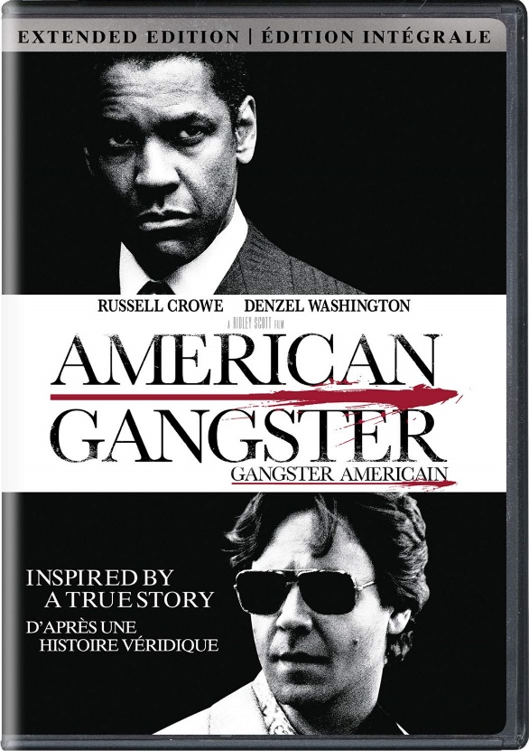
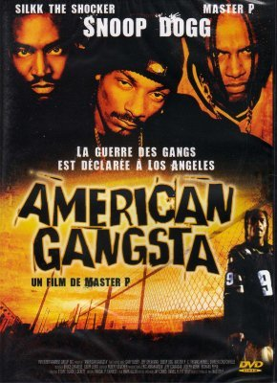
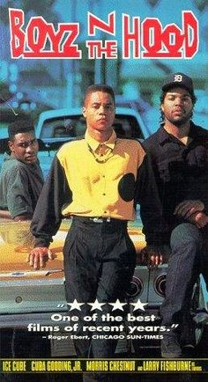
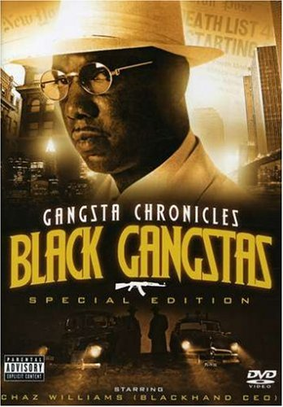
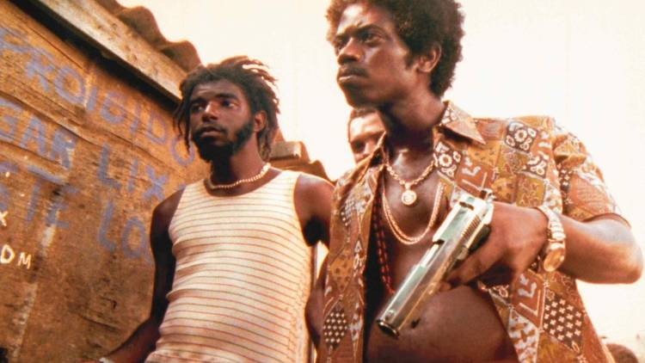
TRUTH or TROPE?: Combine Career Criminal + Villain= Gangsta Thug
TRUTH or TROPE?
Black men in media are often portrayed in stereotypical roles (thugs, pimps, gangsters) which supports the American blacks as criminals label (Chochran, Dhillon, Rabow, Vega, & Yeghnazar, 2012). Moreover, an element of criminality remains a constant character trait often associated with these characters (Noakes, 2003).
TROPE!
Notes:
TRUTH or TROPE? Combine Career Criminal + Villain= Gangsta Thug
Black men in media are often portrayed in stereotypical roles (thugs, pimps, gangsters) which supports the American blacks as criminals label (Chochran, Dhillon, Rabow, Vega, & Yeghnazar, 2012). Moreover, an element of criminality remains a constant character trait often associated with these characters (Noakes, 2003).

Slide 42
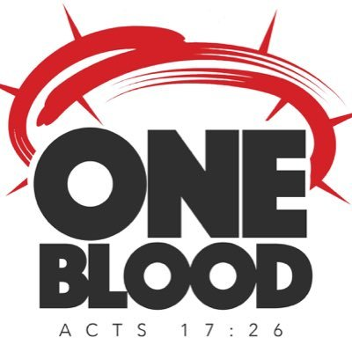
TRUTH or TROPE?: Combine Career Criminal + Villain= Gangsta Thug
This pervasive trope perpetuates long-held stereotypes that American blacks are manifestly criminogenic in and of themselves, and further fuels prejudices (Fujioka, 2005).
Martin Luther King, Jr.
Benjamin O. Davis, Jr.
Frederick Douglas
Ben Carson
Thurgood Marshall
Booker T. Washington
Muhammad Ali
Jackie Robinson
Langston Hughes
George Washington Carver
Former President Barack Obama
Heart Surgeon Daniel Hale Williams
Inventor Garret Morgan
Robert Augustus Sweeney (2x MOH recipient) along with 89 other American black recipients.
TRUTH!
Notes:
TRUTH or TROPE? Combine Career Criminal + Villain= Gangsta Thug
This pervasive trope perpetuates long-held stereotypes that American blacks are manifestly criminogenic in and of themselves, and further fuels prejudices (Fujioka, 2005).
Martin Luther King, Jr.
Benjamin O. Davis, Jr.
Frederick Douglas
Ben Carson
Thurgood Marshall
Booker T. Washington
Muhammad Ali
Jackie Robinson
Langston Hughes
George Washington Carver
Former President Barack Obama
Heart Surgeon Daniel Hale Williams
Inventor Garret Morgan
Robert Augustus Sweeney (2x MOH recipient) along with 89 other American black recipients.

Slide 43
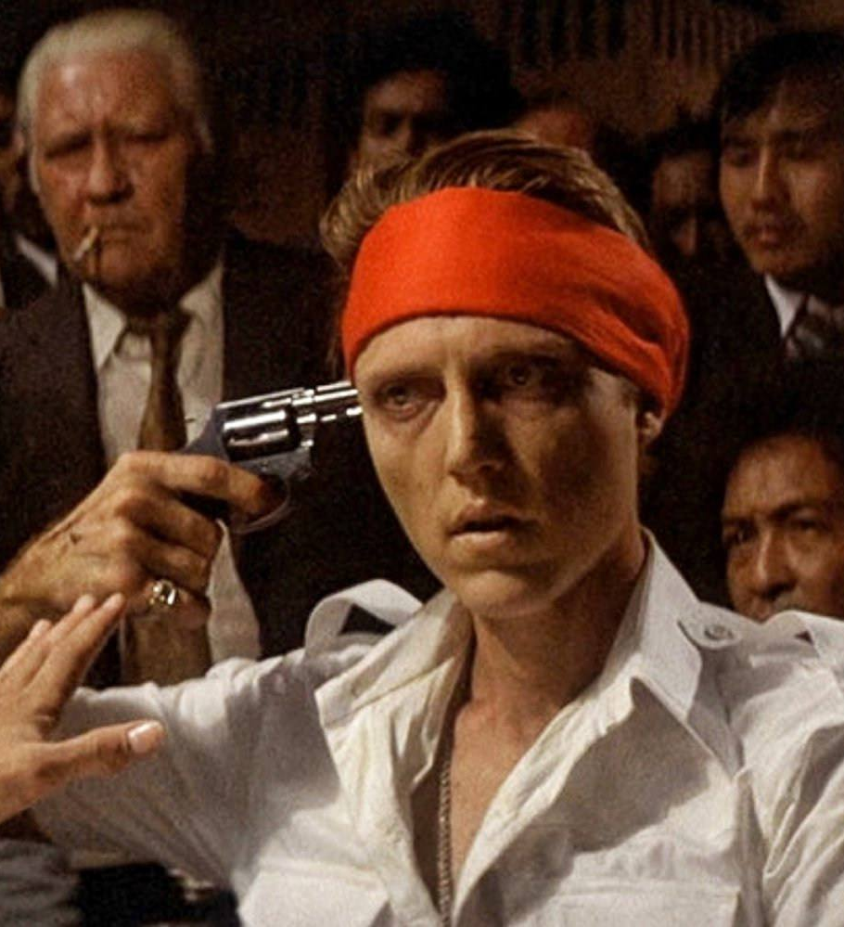
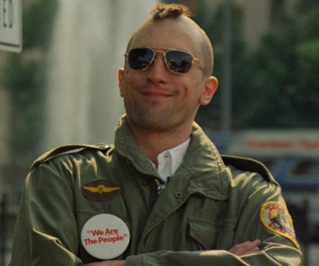
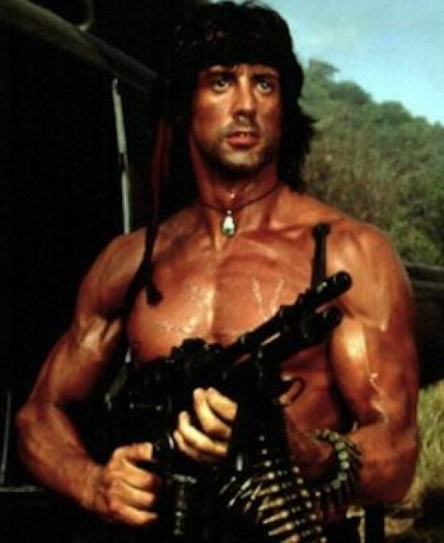
TRUTH or TROPE?: Combine the Warrior + Wildly Insane = Crazy Vet
TRUTH or TROPE?
The vast majority of combat veterans suffer from a mental disorder called post traumatic stress disorder.
TROPE!
Notes:
TRUTH or TROPE? Warrior + Wildly Insane = Crazy Veteran
The vast majority of combat veterans suffer from a mental disorder called post traumatic stress disorder.

Slide 44
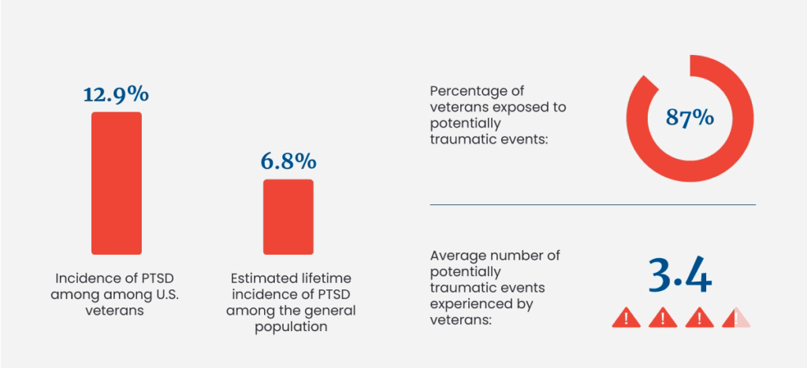
TRUTH or TROPE?: Combine the Warrior + Wildly Insane = Crazy Vet
Statistics show that 6% to 8% of the general population suffer from post-traumatic stress disorder with fewer than 15% exposed to at least 1 traumatizing event. Across the entire U.S., about 8 million U.S. adults have PTSD in a given year.
Meanwhile, 87% of combat veterans are exposed to on average 3.4 traumatizing events, yet less than 13% of veterans ever show any symptoms of post-traumatic stress or a stress related metal disorder.
TRUTH!
National Library of Medicine: National Center for Biotechnology Information, pubmed.ncbi.nlm.nih.gov, Gaylord, et al.
US Department of Veterans Affairs, www.ptsd.va.gov
Notes:
TRUTH or TROPE? Warrior + Wildly Insane = Crazy Veteran
Statistics show that 6 to 8% of the general population suffer from post traumatic stress disorder with fewer than 15% exposed to at least 1 traumatizing event. Across the entire U.S., about 8 million U.S. adults have PTSD in a given year.
Meanwhile, 87% of combat veterans are exposed to on average 3.4 traumatizing events, yet less than 13% of veterans ever show any symptoms of post traumatic stress or a stress related metal disorder.

Slide 45
Tropes
“A trope is, effectively, a widely-used but importantly widely-accepted dramatic device.”
-Paul FitzSimons
Combining Archetypes to generate Tropes
http://SuccessfulChristianSelfPublishing.com/MoreThanBW/
Notes:
Tropes
Combining Archetypes to generate Tropes
“A trope is, effectively, a widely-used but importantly widely-accepted dramatic device.”
-Paul FitzSimons

Slide 46
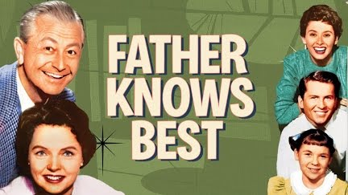
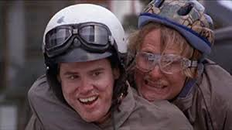
Tropes
A Trope is essentially a commonly accepted “dramatic truth” and can represent a character or a common theme in the narrative.
Combine a few Archetypes and you likely have some recognizable character tropes.
For example: Lover (Husband) + Harlequin
Notes:
A Trope is essentially a commonly accepted “dramatic truth” and can represent a character or a common theme in the narrative.
Combine a few Archetypes and you likely have some recognizable character tropes.
For example: Lover (Husband) + Harlequin

Slide 47
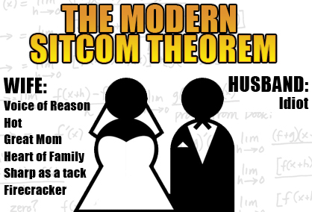
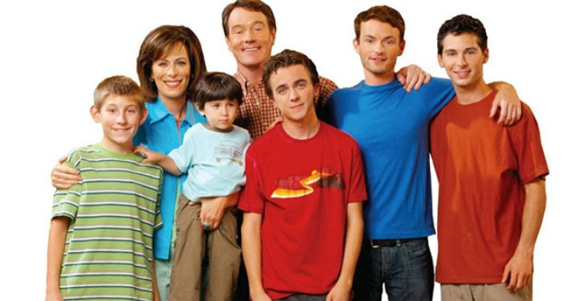
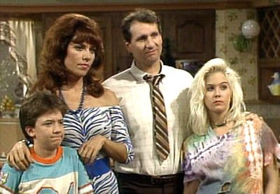
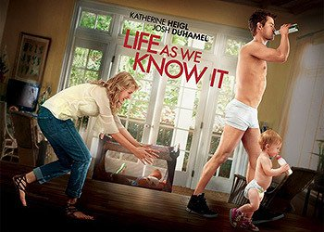
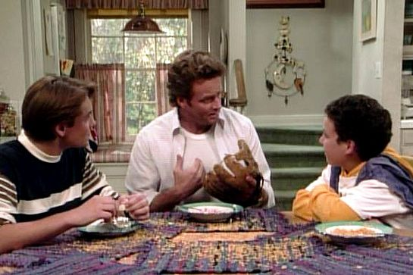
Lover + Harlequin = Idiot Husband
Notes:
Lover + Harlequin = Idiot Husband

Slide 48
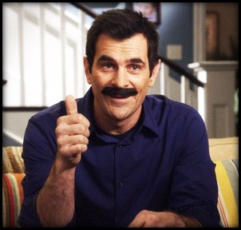
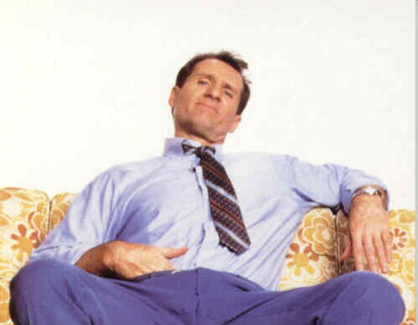
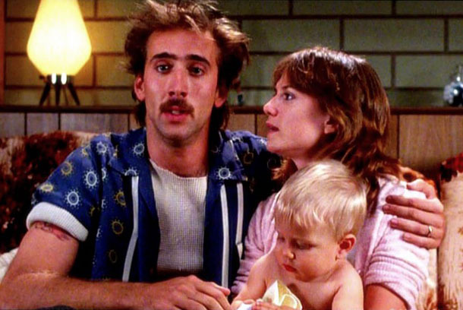
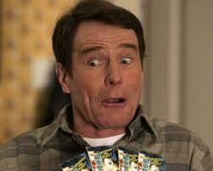
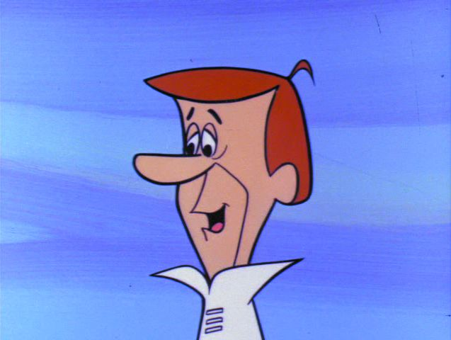
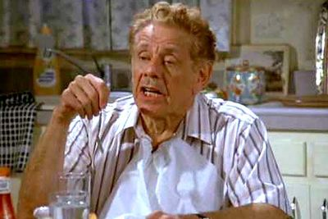
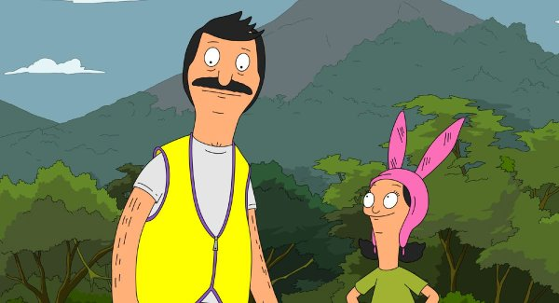
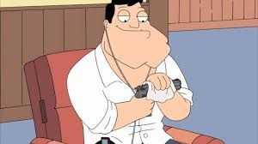
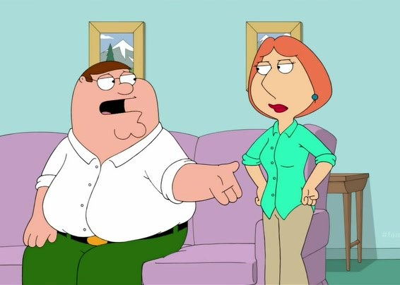
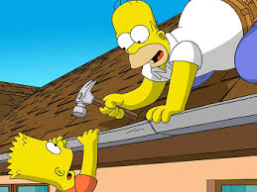
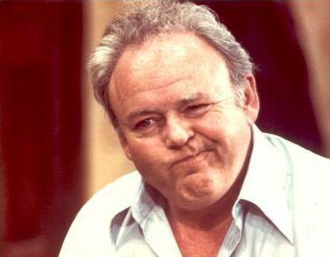
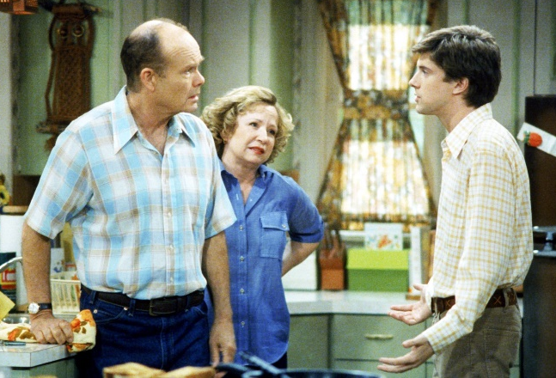
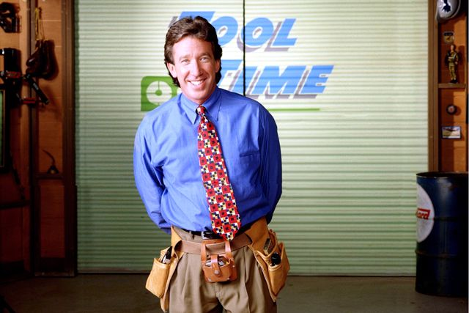
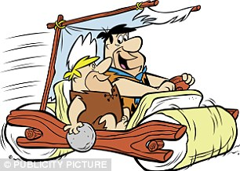
Father Figure + Harlequin = Idiot Dad
Notes:
Father Figure + Harlequin = Idiot Dad

Slide 49
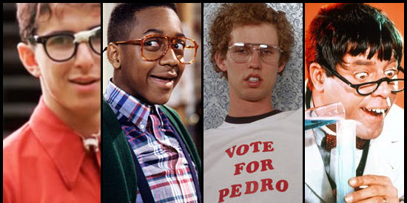
Mentally/Socially Disabled + Harlequin = Autistic Clown
Notes:
Mentally/Socially Disabled + Harlequin = Autistic Clown

Slide 50
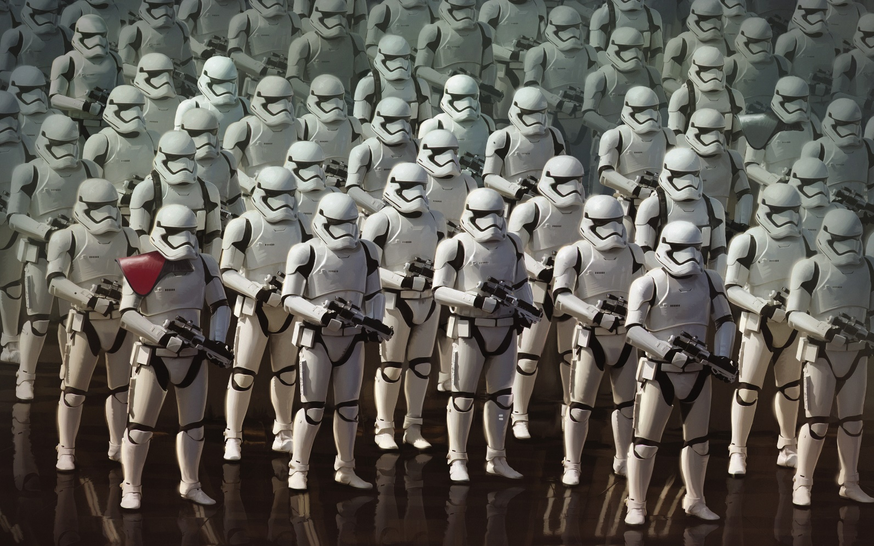
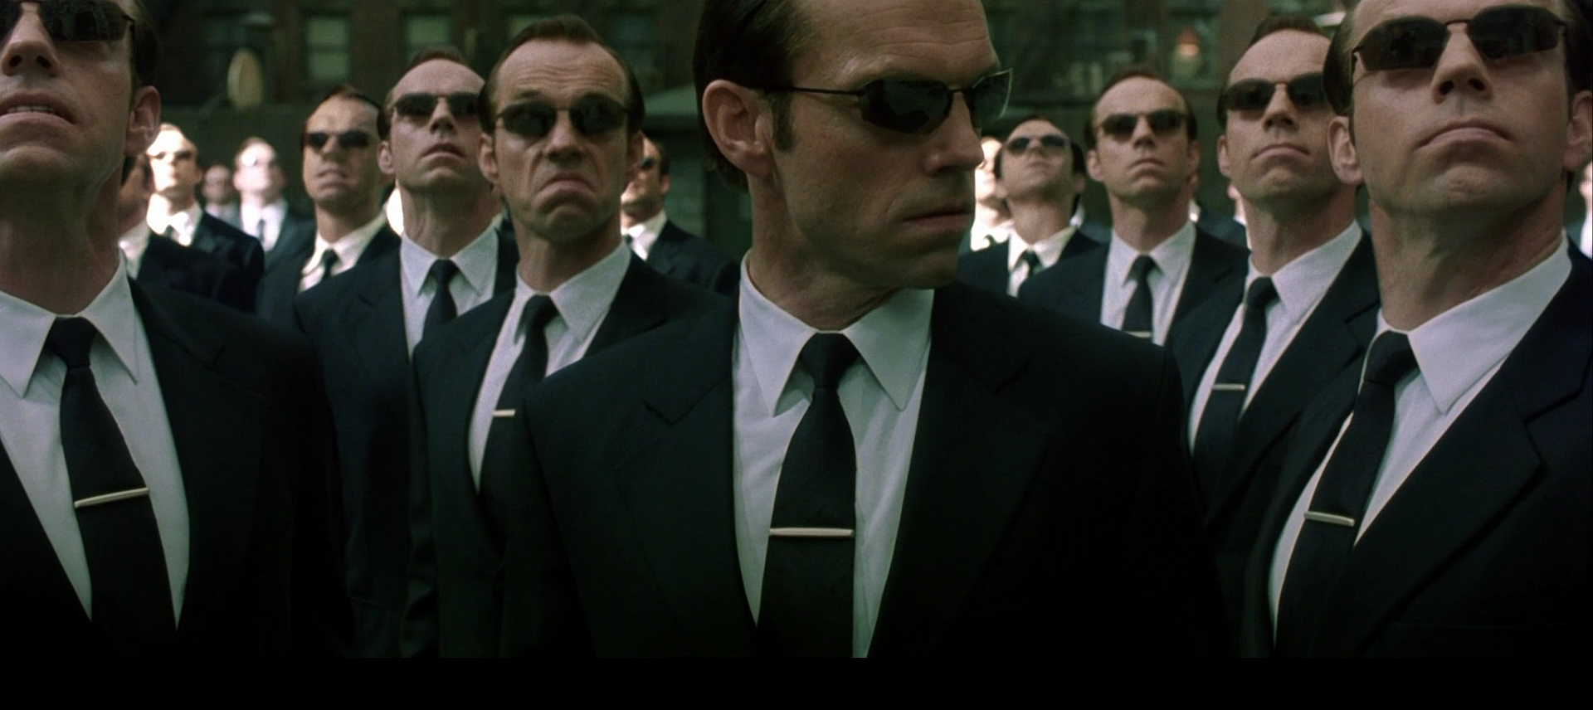
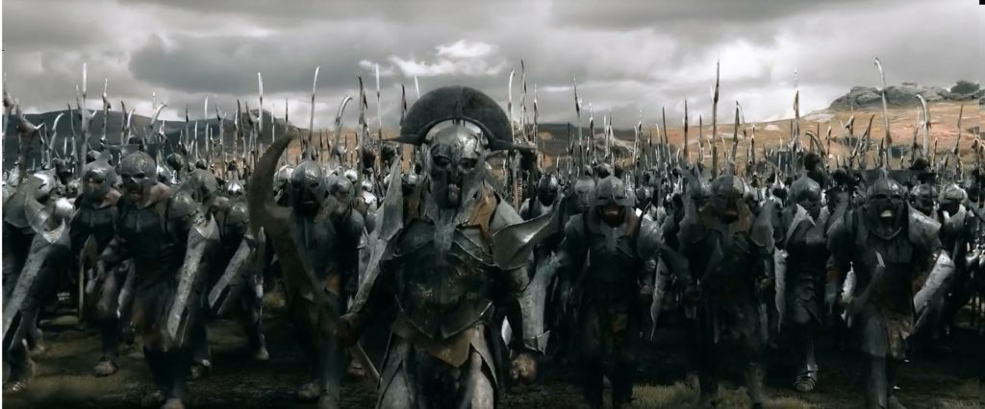
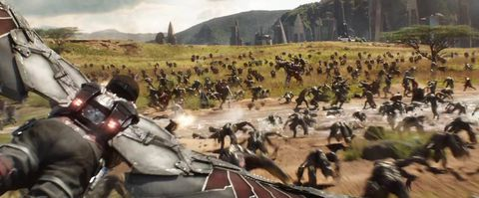
Warrior + Dumb Muscle = Mindless Drone
Notes:
Warrior + Dumb Muscle = Mindless Drone

Slide 51
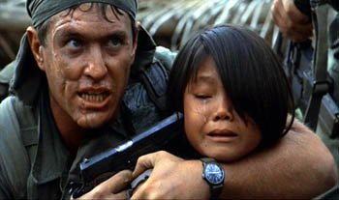
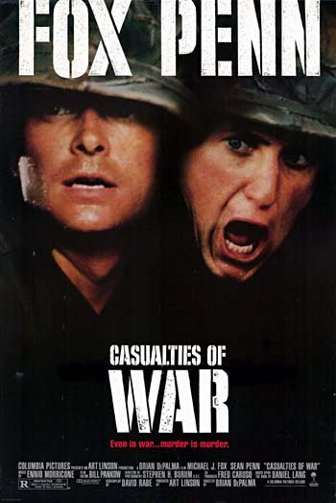
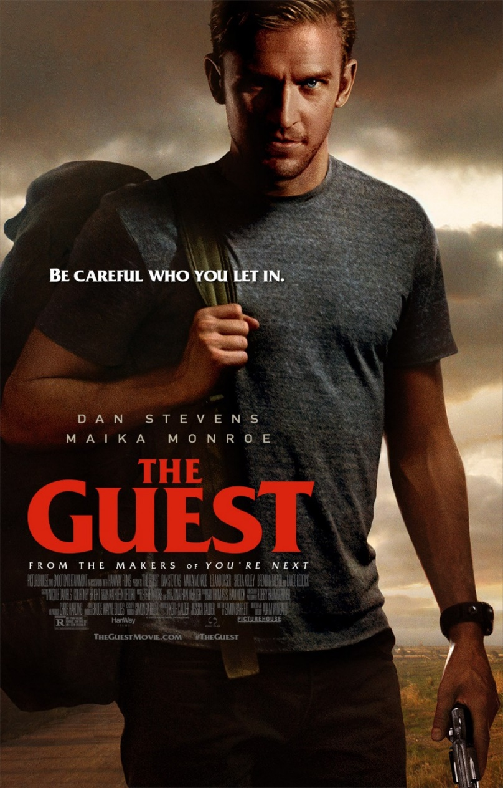
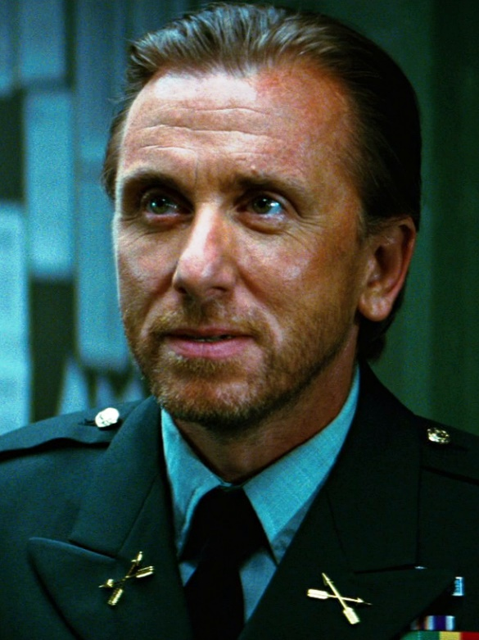
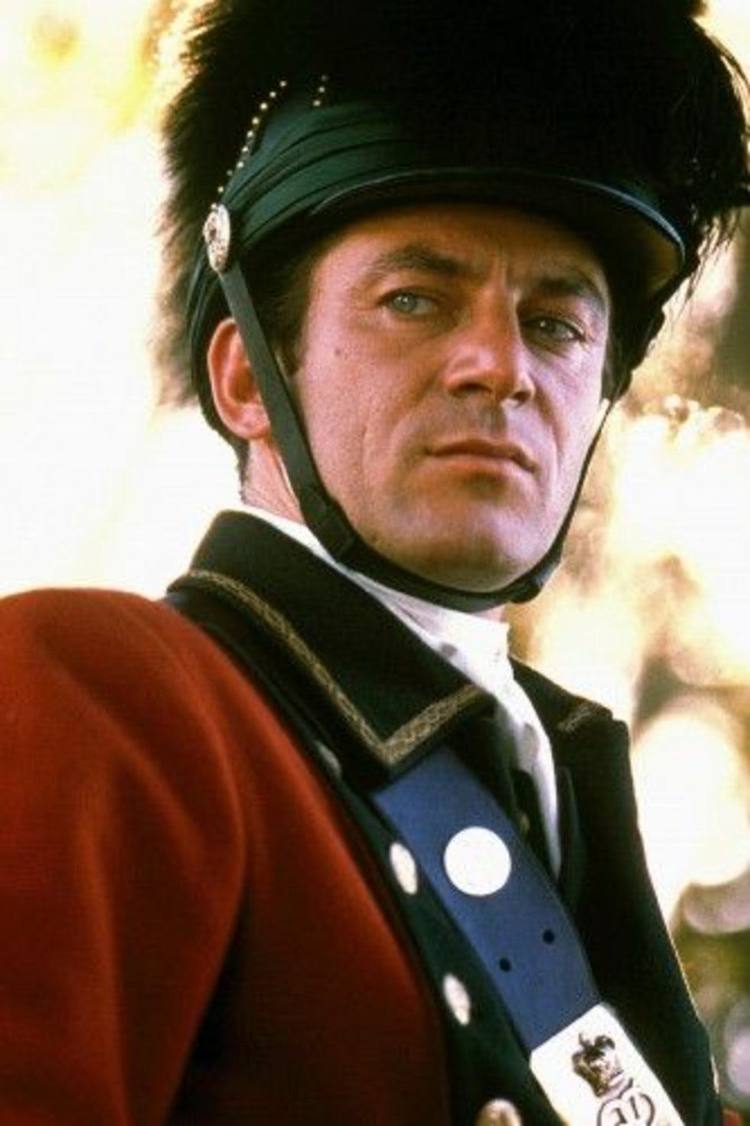
Warrior + Psychopath = Sociopathic Soldier
Notes:
Warrior + Psychopath = Sociopathic Soldier

Slide 52
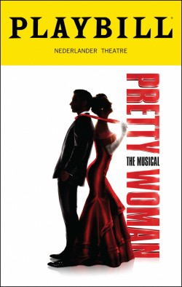
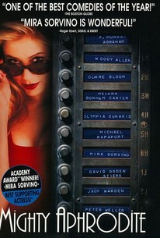
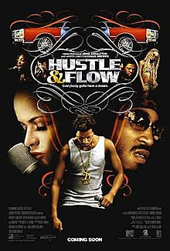
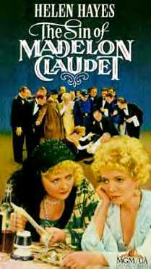
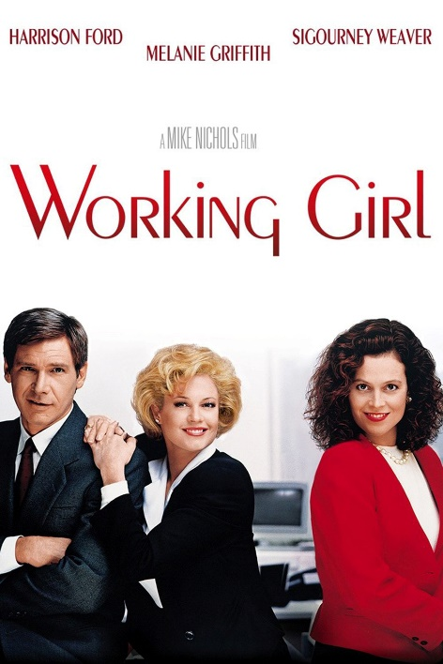
Prostitute + McCoy = Sympathetic Sinner
aka “Hooker with the Heart of Gold”
Notes:
Prostitute + McCoy = Sympathetic Sinner

Slide 53
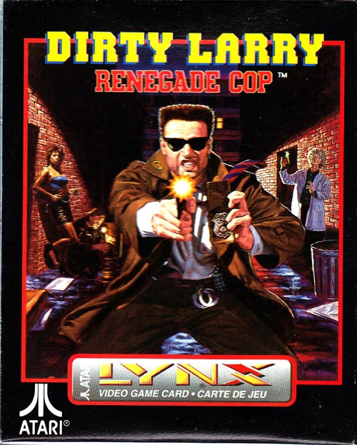
You get the idea
Girl Next Door + Wildly Crazy
= Crazy Ex [Dated once, girlfriend, wife, or ex]
Prostitute + Grande Dame
= The Gold Digger
Warrior + Rebel
= Renegade Cop / Criminal Cop
Notes:
Girl Next Door + Wildly Crazy = "Crazy" [Dated once, girlfriend, wife, or holder of an unknown and unrequited crush]
Prostitute + Grande Dame = The Gold Digger
Warrior + Rebel = Renegade Cop / Criminal Cop

Slide 54
Toss Out the Tropes!
Toss out the tropes to avoid perpetuating stereotypes
http://SuccessfulChristianSelfPublishing.com/MoreThanBW/
Notes:
Toss Out the Tropes!
Toss out the tropes to avoid perpetuating stereotypes

Slide 55
Tropes to Avoid (Male vs. Female)
Men/Boys
Women/Girls
Men:
Misogony dialogue “She’d be prettier if ___, All women, girls can’t, chicks always, little lady, Feminazi”
Commitment Phobic
Young men
Oversexed, delinquent, entitled, immoral
Boys
Dirty, mean, annoying, bullyish, dumb
Women
Misandry: “mansplaining, manalogue, he had a mantrum, manterrupting, toxic masculinity, All men, boys can’t, men always, men can’t possibly understand”
Desperate for commitment
Young women
Anti-male, disrespectful, selfish, promiscuous
Girls
Angelic, clean, sweet, smart, fair/just
Notes:
Tropes to Avoid (Male vs. Female)
Men/Boys
Men:
Misogony dialogue “She’d be prettier if ___, All women, girls can’t, chicks always, little lady, Feminazi”
Commitment Phobic
Young men
Oversexed, delinquent, entitled, immoral
Boys
Dirty, mean, annoying, bullyish, dumb
Women/Girls
Women
Misandry: “mansplaining, manalogue, he had a mantrum, manterrupting, toxic masculinity, All men, boys can’t, men always, men can’t possibly understand”
Desperate for commitment
Young women
Anti-male, disrespectful, selfish, promiscuous
Girls
Angelic, clean, sweet, smart, fair/just

Slide 56
Tropes to Avoid (Asian people group)
Yellow Peril: an "oriental" criminal and/or political mastermind, a character originating in the xenophobic days of the late 19th century, but popular ever since.
Yellowface: East Asian characters are portrayed by actors of other races while wearing make-up to give them the appearance of an East Asian person, often including epicanthic folds and queue hairstyles.
Asian Speekee Engrish: A common stereotype (covered in dialogue)
Interchangeable Asian Cultures: Fortune cookies. ‘Nough said.
Mighty Whitey, Mellow Yellow: white male in relationship with a disadvantaged, or submissive, Asian woman.
Asian and nerdy: good students, come from good families and don't have any economic problems
All Asians are Martial Arts Experts: Seen a movie where he doesn’t know kung fu?
Asian Store Owners: Let’s meet at Arnold’s after school
Identical Looking Asians: Queue hairstyles, peasant hats/dress, identical kimonos or other apparel
Notes:
Tropes to Avoid (Asian people group)
Yellow Peril: an "oriental" criminal and/or political mastermind, a character originating in the xenophobic days of the late 19th century, but popular ever since.
Yellowface: East Asian characters are portrayed by actors of other races while wearing make-up to give them the appearance of an East Asian person, often including epicanthic folds and queue hairstyles.
Asian Speekee Engrish: A common stereotype (covered in dialogue)
Interchangeable Asian Cultures: Fortune cookies. ‘Nough said.
Mighty Whitey, Mellow Yellow: white male in relationship with a disadvantaged, or submissive, Asian woman.
Asian and nerdy: good students, come from good families and don't have any economic problems
All Asians are Martial Arts Experts: Seen a movie where he doesn’t know kung fu?
Asian Store Owners: Let’s meet at Arnold’s after school
Identical Looking Asians: Queue hairstyles, peasant hats/dress, identical kimonos or other apparel

Slide 57
Tropes to Avoid (Asian people group)
The 1961 film Breakfast at Tiffany’s features Andy Rooney in “Yellowface” portraying the bucktoothed Mr. Yunioshi speaking Pidgeon “Engrish.”
David Carradine in the TV series Kung Fu
Scarlett Johansen in the live action film Ghost in the Shell
Tilda Swinton in Doctor Strange.
Notes:
Examples:
The 1961 film Breakfast at Tiffany’s features Andy Rooney in “Yellowface” portraying the bucktoothed Mr. Yunioshi speaking Pidgeon “Engrish.”
David Carradine in the TV series Kung Fu
Scarlett Johansen in the live action film Ghost in the Shell
Tilda Swinton in Doctor Strange.

Slide 58
Tropes to Avoid (Germans)
The most common stereotype about Germans in movies since 2000 is that they are all Nazis.
Second place goes to German scientists, filed under "Herr Doctor" on TVTropes.
All Germans' supposedly actor David Hasselhoff.
All Germans operate with military precision and efficiency at all times.
Notes:
Tropes to Avoid (Germans)
The most common stereotype about Germans in movies since 2000 is that they are all Nazis.
Second place goes to German scientists, filed under "Herr Doctor" on TVTropes.
All Germans' supposedly actor David Hasselhoff.
All Germans operate with military precision and efficiency at all times.

Slide 59
Tropes to Avoid (United Kingdom)
James Bond aside, British characters overwhelmingly seem to be a popular choice for villains.
British are all arrogant, uptight, and speak with a classic posh accent.
British are mean, especially to small animals and children (see Oliver Twist)
Notes:
Tropes to Avoid (United Kingdom)
James Bond aside, British characters overwhelmingly seem to be a popular choice for villains.
British are all arrogant, uptight, and speak with a classic posh accent.
British are mean, especially to small animals and children (see Oliver Twist)

Slide 60
Tropes to Avoid (Russian)
Russians are portrayed as "hard-fightin', heavy-drinkin', manly, boorish" characters.
Russians lead hard lives, often in poverty.
Most often played in films by non-Russians. In Rocky IV, the Swedish Dolph Lundgren started his action career as Russian boxer Ivan Drago; Arnold Schwarzenegger in Red Heat; and Viggo Mortensen in Eastern Promises
Notes:
Tropes to Avoid (Russian)
Russians are portrayed as "hard-fightin', heavy-drinkin', manly, boorish" characters.
Russians lead hard lives, often in poverty.
Most often played in films by non-Russians. In Rocky IV, the Swedish Dolph Lundgren started his action career as Russian boxer Ivan Drago; Arnold Schwarzenegger in Red Heat; and Viggo Mortensen in Eastern Promises

Slide 61
Tropes to Avoid (Blacks)
Black men are portrayed as “Hypermasculine” as in scary/angry.
If people die in a movie, the black character is the most likely to die first.
If a film features one black character, it's likely to be the black best friend.
Black women are portrayed as loudmouthed/sassy.
"Darkest Africa" movies portray the continent as a mysterious and dangerous isolated land with only limited ties to "modern" civilization.
Notes:
Tropes to Avoid (Blacks)
Black men are portrayed as “Hypermasculine” as in scary/angry.
If people die in a movie, the black character is the most likely to die first.
If a film features one black character, it's likely to be the black best friend.
Black women are portrayed as loudmouthed/sassy.
"Darkest Africa" movies portray the continent as a mysterious and dangerous isolated land with only limited ties to "modern" civilization.

Slide 62
Break the mold. Be original.
“Trope” Tests to identify archetypes, tropes, and stereotypes.
Notes:
Break the mold. Be original.
Tests to identify archetypes, tropes, and stereotypes.

Slide 63
The Substitution Test
The simplest test for sexist remarks is to substitute the opposite sex.
A: What's the smartest thing a husband can say?
Q: ”My wife says....“
Substitute the opposite sex. Does it diminish the opposite sex?
A: What's the smartest thing a wife can say?
Q: ”My husband says....“
Notes:
The Substitution Test
The simplest test for sexist remarks is to substitute the opposite sex.
A: What's the smartest thing a husband can say?
Q: ”My wife says....“
Substitute the opposite sex. Does it diminish the opposite sex?
A: What's the smartest thing a wife can say?
Q: ”My husband says....“

Slide 64
The Substitution Test for People Groups
The simplest test for prejudicial language is to imagine you are a member of an imaginary people group, such as Smogarians, then substitute that imaginary people group into any statement on a specific nonfictional people group.
Take this example from the Coca-Cola company’s “Better Together” online training seminar.
White people are socialized to feel they are inherently superior because they are white.
White people are arrogant and defensive. Break with white solidarity. Be less white.
Substitute the fictional Smogarian people for white people. Are the remarks prejudicial toward the Smogarian people group?
Smogarians are socialized to feel they are inherently superior because they are Smogarian.
Smogarians are arrogant and defensive. Break with Smogarian solidarity. Be less Smogarian.
Notes:
The Substitution Test for People Groups
The simplest test for prejudicial language is to substitute an imaginary people group, such as Smogarians, for any statement on a specific people group.
Take this example from the Coca-Cola company’s “Better Together” online training seminar.
White people are socialized to feel they are inherently superior because they are white.
White people are arrogant and defensive. Break with white solidarity. Be less white.
Substitute the fictional Smogarian people for white people. Are the remarks prejudicial toward the Smogarian people group?
Smogarians are socialized to feel they are inherently superior because they are Smogarian.
Smogarians are arrogant and defensive. Break with Smogarian solidarity. Be less Smogarian.

Slide 65
The Bechdel Test
The Bechdel Test (sometimes called the Bechdel-Wallace Test) for on-screen female characters has been around since at least 1985. It is designed to determine whether or not on-screen female characters have fully realized lives apart from men.
The basis of the test is to examine a film or a TV episode and answer three questions:
Does it have at least two [named] women in it?
Do they talk to each other?
Do they talk about something besides a man, or men?
Any film or TV episode that can answer “yes” to all three questions passes the test.
Notes:
The Bechdel Test
The Bechdel Test (sometimes called the Bechdel-Wallace Test) for on-screen female characters has been around since at least 1985. It is designed to determine whether or not on-screen female characters have fully realized lives apart from men.
The basis of the test is to examine a film or a TV episode and answer three questions:
Does it have at least two [named] women in it?
Do they talk to each other?
Do they talk about something besides a man, or men?
Any film or TV episode that can answer “yes” to all three questions passes the test.

Slide 66
The DuVernay Test
In 2016, New York Times film critic Manohla Dargis developed the DuVernay Test, named for director Ava DuVernay (Selma, A Wrinkle In Time). The basis of the 5 question test is to answer the question:
Do on-screen minority characters have fully realized lives rather than serve as scenery for non-minority characters?
Does it have at least two [named] minority characters in it?
Do the minority characters portray harmful, simplistic, or common archetypes, tropes, or stereotypes?
Do the minority characters talk to each other, and about anything other than color?
Do only the minority characters die, or do they die first?
Do the minority characters pursue their own goals apart from the goals of any majority characters?
Notes:
The DuVernay Test
In 2016, New York Times film critic Manohla Dargis developed the DuVernay Test, named for director Ava DuVernay (Selma, A Wrinkle In Time). The basis of the 5 question test is to answer the question:
Do on-screen minority characters have fully realized lives rather than serve as scenery for non-minority characters?
Does it have at least two [named] minority characters in it?
Do the minority characters portray harmful, simplistic, or common archetypes, tropes, or stereotypes?
Do the minority characters talk to each other, and about anything other than color?
Do only the minority characters die, or do they die first?
Do the minority characters pursue their own goals apart from the goals of any majority characters?

Slide 67
I think I Just Tested Positive!
What do I do when I find that my story is tropish?
Notes:
I think I Just Tested Positive!
What do I do when I find that my story is tropish?

Slide 68
I tested positive! Now what?
It’s okay. Tropes aren’t always BAD!
A Trope is sort of like a marriage.
When you do it well, and make a good marriage, there’s nothing better.
When you don’t do it well, and make a bad marriage, there’s nothing worse.
Notes:
I tested positive! Now what?
It’s okay. Tropes aren’t always BAD!
A Trope is sort of like a marriage.
When you do it well, and make a good marriage, there’s nothing better.
When you don’t do it well, and make a bad marriage, there’s nothing worse.

Slide 69
The Very Best Advice
Write from the heart.
Be true to your story.
Notes:
The Very Best Advice
Write from the heart.
Be true to your story.

Slide 70
I tested positive! Now what?
Deconstruction. Embrace the trope and RUN with it in order to encourage discussion about that trope.
For example, in Madame Bovary, the titular character spends all her time reading romance novels, and bases all of her actions and decisions on them the hope that it will turn her own life into the fairytales she reads. (Spoiler Alert!: there is no Happily Ever After.)
Subversion. Give readers the sense that a trope is playing out as expected, only to defy their predictions when the story unfolds in a different manner.
For example, in the film Life As We Know It, the heroine rushes to the airport to declare her love for the recently estranged co-parent of their adopted child, thus playing out the “Belated Love Epiphany” trope. She is stopped at every turn by Atlanta traffic, ticket agents, and TSA and returns home, sans love confession. When she walks into the house, he is there waiting for her.
Notes:
I tested positive! Now what?
Deconstruction. Embrace the trope and RUN with it in order to encourage discussion about that trope.
For example, in Madame Bovary, the titular character spends all her time reading romance novels, and bases all of her actions and decisions on them the hope that it will turn her own life into the fairytales she reads. (Spoiler Alert!: there is no Happily Ever After.)
Subversion. Give readers the sense that a trope is playing out as expected, only to defy their predictions when the story unfolds in a different manner.
For example, in the film Life As We Know It, the heroine rushes to the airport to declare her love for the recently estranged co-parent of their adopted child, thus playing out the “Belated Love Epiphany” trope. She is stopped at every turn by Atlanta traffic, ticket agents, and TSA and returns home, sans love confession. When she walks into the house, he is there waiting for her.

Slide 71
How do I describe minority characters without offense?
Describe minority characters without compromising the story.
Notes:
Links & Resources
Web based resources, Christian books, and Secular books that deal with the nature and character of men.

Slide 72
How to Describe Minority Characters
One way to describe the character is via the book cover.
Notes:
How to Describe Minority Characters
One way to describe the character is via the book cover.

Slide 73
How to Describe Minority Characters
Use POINT OF VIEW
Minority Character’s POV:
Rachel never liked her straight black hair that every other Korean she knew also had. She wanted to die her hair bright pink on her eighteenth birthday.
Main Character’s or Love interest's POV:
Mark looked down at their clasped fingers, admiring the contrast of his relatively light skin and her dark skin as much as he admired the warmth of her touch.
Villain's POV:
Boris despised everything about the man from his Asian features to his unshakable faith.
Notes:
How to Describe Minority Characters
Use POINT OF VIEW
Minority Character’s POV:
Rachel never liked her straight black hair that every other Korean she knew also had. She wanted to die her hair bright pink on her eighteenth birthday.
Main Character’s or Love interest's POV:
Mark looked down at their clasped fingers, admiring the contrast of his relatively light skin and her dark skin as much as he admired the warmth of her touch.
Villain's POV:
Boris despised everything about the man from his Asian features to his unshakable faith.

Slide 74
What about Sensitivity Readers?
(Translated) Do I have to do my research?
Notes:
What about Sensitivity Readers?
(Translated) Do I have to do my research?

Slide 75
Research Readers (Sensitivity Readers)
If you are not an expert or have no personal or practical experience with your subject matter, it makes perfect sense to have someone who is read your work for flaws.
Are you an attorney, a veteran, a surgeon, or a member of a minority group?
If so, then you probably don’t need a research reader.
If not, then you need to complete your research by having it validated.
Notes:
Research Readers (Sensitivity Readers)
If you are not an expert or have no personal or practical experience with your subject matter, it makes perfect sense to have someone who is read your work for flaws.
Are you an attorney, a veteran, a surgeon, or a member of a minority group?
If so, then you probably don’t need a research reader.
If not, then you need to complete your research by having it validated.

Slide 76
Set SMART GOALS with your Research Reader
SMART (Specific, Measurable, Achievable, Realistic, and Timely)
GOALS (Godly Objectives Assure Lasting Success)
SPECIFIC:
Front load your selected reader with up to 3 specific questions.
MEASURABLE:
Word the questions so that responses are measurable. (T/F? Scale of 1 to 10)
ACHEIVABLE:
Ensure your reader has expertise within your areas of concerns so that you achieve results.
REALISTIC:
Keep the questions focused and realistic.
TIMELY:
Agree upon a deadline to receive responses so they are timely.
Be anxious for nothing, but in everything by prayer and supplication, with thanksgiving, let your requests be made known to God—Phil 4:6
Notes:
Set SMART GOALS with your Research Reader
SMART (Specific, Measurable, Achievable, Realistic, and Timely)
GOALS (Godly Objectives Assure Lasting Success)
SPECIFIC:
Front load your selected reader with up to 3 specific questions.
MEASURABLE:
Word the questions so that responses are measurable. (T/F? Scale of 1 to 10)
ACHEIVABLE:
Ensure your reader has expertise within your areas of concerns so that you achieve results.
REALISTIC:
Keep the questions focused and realistic.
TIMELY:
Agree upon a deadline to receive responses so they are timely.
Be anxious for nothing, but in everything by prayer and supplication, with thanksgiving, let your requests be made known to God—Phil 4:6

Slide 77
The Very Best Advice Remains
Write from the heart.
Be true to your story.
Notes:
The Very Best Advice Remains
Write from the heart.
Be true to your story.

Slide 78
Links & Resources
Web based resources, Christian books, and Secular books that deal with the nature and character of men.
Notes:
Links & Resources
Web based resources, Christian books, and Secular books that deal with the nature and character of men.

Slide 79
Resources:
(Online)
Focus on the Family Marriage Resources www.focusonthefamily.com/topic/marriage/
God's Design for Marriage www.focusonthefamily.com/marriage/gods-design-for-marriage/
Writing Tip to Handle RACE successfulchristianselfpublishing.com/writing-tip-to-handle-race/
(Christian Books)
The Five Love Languages by Gary Chapman
Love and Respect: The Love She Most Desires; the Respect He Desperately Needs by Dr. Emerson Eggerichs
Romancing Your Husband by Debra White Smith
For Women Only by Shaunti Feldhahn
For Men Only by Shaunti Feldhahn
Love’s Letters by Shaunti Feldhahn, Gregg & Hallee Bridgeman, Scott & Leah Silverii, Juan & Ruthy Martinez, Shawn Lovejoy, Michael & Alicia Rowntree, Alicia Rowntree, Sheri Bright, Tricia Lovejoy, et al.
Notes:
Resources:
(Online)
Focus on the Family Marriage Resources www.focusonthefamily.com/topic/marriage/
God's Design for Marriage www.focusonthefamily.com/marriage/gods-design-for-marriage/
Writing Tip to Handle RACE successfulchristianselfpublishing.com/writing-tip-to-handle-race/
(Christian Books)
The Five Love Languages by Gary Chapman
Love and Respect: The Love She Most Desires; the Respect He Desperately Needs by Dr. Emerson Eggerichs
Romancing Your Husband by Debra White Smith
For Women Only by Shaunti Feldhahn
For Men Only by Shaunti Feldhahn
Love’s Letters by Shaunti Feldhahn, Gregg & Hallee Bridgeman, Scott & Leah Silverii, Juan & Ruthy Martinez, Shawn Lovejoy, Michael & Alicia Rowntree, Alicia Rowntree, Sheri Bright, Tricia Lovejoy, et al.

Slide 80
Resources:
Intended for Pleasure by Ed Wheat
Finding the Hero in Your Husband: Surrendering the Way God Intended by Juli Slattery
Raising Men, Not Boys by Mike Fabarez
His Needs, Her Needs: Building an Affair-Proof Marriage by Willard F. Harley Jr.
No More Headaches: Enjoying Sex & Intimacy in Marriage by Juli Slattery
His Brain, Her Brain: How Divinely Designed Differences Can Strengthen Your Marriage by Barb Larimore and Walt Larimore M.D.
Sacred Marriage: What If God Designed Marriage to Make Us Holy More Than to Make Us Happy? by Gary Thomas
The Excellent Wife: A Biblical Perspective by Martha Peace
The Exemplary Husband: A Biblical Perspective by Stuart Scott
Sheet Music: Uncovering the Secrets of Sexual Intimacy in Marriage by Kevin Leman
You Can Be the Wife of a Happy Husband by Darien B. Cooper
Guys are Waffles, Girls are Spaghetti by Chad Eastham
Notes:
Resources:
(Christian Books)
Intended for Pleasure by Ed Wheat
Finding the Hero in Your Husband: Surrendering the Way God Intended by Juli Slattery
Raising Men, Not Boys by Mike Fabarez
His Needs, Her Needs: Building an Affair-Proof Marriage by Willard F. Harley Jr.
No More Headaches: Enjoying Sex & Intimacy in Marriage by Juli Slattery
His Brain, Her Brain: How Divinely Designed Differences Can Strengthen Your Marriage by Barb Larimore and Walt Larimore M.D.
Sacred Marriage: What If God Designed Marriage to Make Us Holy More Than to Make Us Happy? by Gary Thomas
The Excellent Wife: A Biblical Perspective by Martha Peace
The Exemplary Husband: A Biblical Perspective by Stuart Scott
Sheet Music: Uncovering the Secrets of Sexual Intimacy in Marriage by Kevin Leman
You Can Be the Wife of a Happy Husband by Darien B. Cooper
Guys are Waffles, Girls are Spaghetti by Chad Eastham

Slide 81
Resources:
(Secular Books)
Men Are from Mars, Women Are from Venus by John Gray
Why Men Don't Listen and Women Can't Read Maps: How We're Different and What to Do About It by Allan Pease
Notes:
Resources:
(Secular Books)
Men Are from Mars, Women Are from Venus by John Gray
Why Men Don't Listen and Women Can't Read Maps: How We're Different and What to Do About It by Allan Pease

Slide 82
Men are More than Black and White
http://SuccessfulChristianSelfPublishing.com/MoreThanBW/
Notes:
Questions?

