Slide 1
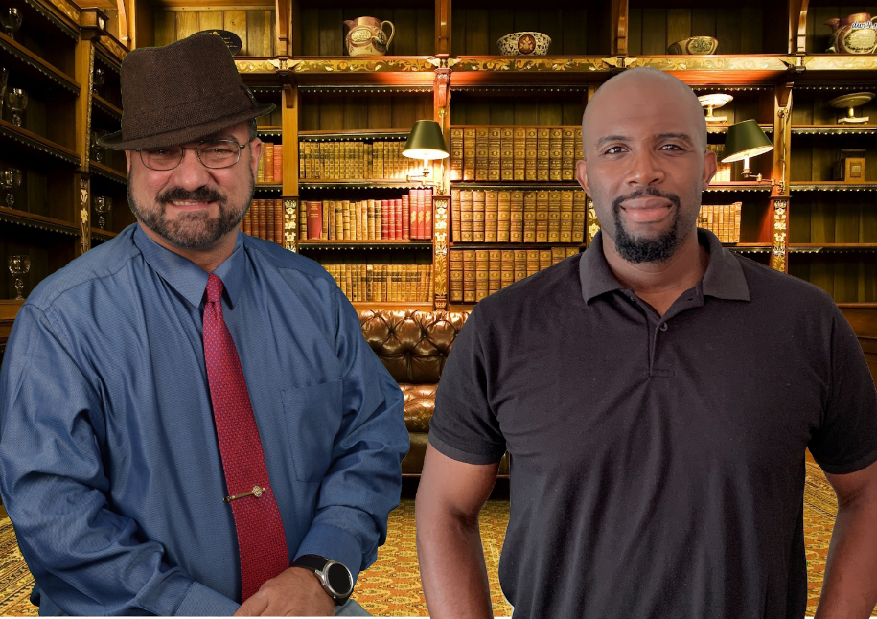
Toss Out Male Tropes:
Men are More Than Black and White
Part 2: He Said/She Said — Crafting Super Realistic Dialogue
JP Robinson & Gregg Bridgeman
Notes:
Toss Out Male Tropes:
Men are More Than Black and White
He Said/She Said—Crafting Super Realistic Dialogue
JP Robinson & Gregg Bridgeman

Slide 2
Successful Christian Self Publishing
http://SuccessfulChristianSelfPublishing.com/MoreThanBW/
This URL will be provided several times.

Slide 3

Why Dialogue Matters
Dialogue instantly reveals your skill as a writer. It’s one of the first things a literary agent or an editor will check when evaluating the marketability of any book.
Notes:
Why is this class important to you?
Dialogue instantly reveals your skill as a writer. It’s one of the first things a literary agent or an editor will check when evaluating the marketability of any book.

Slide 4


Why Dialogue Matters
Dialogue can establish the mood. Playing off characters’ verbal exchanges can set an atmosphere for each scene.
There’s tension in what’s spoken, and especially in what’s not spoken.
Notes:
Good dialogue can establish the mood. Playing off characters’ verbal exchanges can set an atmosphere for each scene.
Good dialogue creates tension in what’s spoken, and especially in what’s not spoken.

Slide 5

Why Dialogue Matters
Dialogue can help establish the backstory and reveal important plot details that the reader may not know about yet.
Notes:
Good dialogue can help establish the backstory and reveal important plot details that the reader may not know about yet.

Slide 6


Why Dialogue Matters
Dialogue is great for ratcheting up the tension between characters.
Tension
Notes:
Good dialogue is great for ratcheting up the tension between characters.

Slide 7


Why Dialogue Matters
Bad dialogue signals the work of an amateur who has failed to grasp the mechanics of speech.
Good dialogue illuminates your characters, moves your plot forward, and develops relationships.
Notes:
Bad dialogue signals the work of an amateur who has failed to grasp the mechanics of speech.
Good dialogue illuminates your characters, moves your plot forward, and develops relationships.

Slide 8

Common Dialogue Tendencies
In my experience, there are three groups of writers.
Most writers fall into one of first two groups:
1.) either they hate writing dialogue and try to avoid it as much as humanly possible, OR
2.) they love writing dialogue and fill their entire novel with mostly useless exchanges.
The third group of writers:
3) understand the importance of dialogue in a story and know how to use dialogue as a tool to enhance their storytelling.
THAT is the group you want to join forever and ever.
Notes:
In my experience, there are three groups of writers. Most writers fall into one of first two groups:
1.) either they hate writing dialogue and try to avoid it as much as humanly possible, OR
2.) they love writing dialogue and fill their entire novel with mostly useless exchanges.
The third group of writers:
3) understand the importance of dialogue in a story and know how to use dialogue as a tool to enhance their storytelling.
THAT is the group you want to join forever and ever.

Slide 9


Agenda (Three Acts)
I. Characteristics of Good Dialogue
II. He Said / She Said
III. Techniques for Super Realistic dialogue
Notes:
Agenda (Three Acts)
I. Characteristics of Good Dialogue
II. He Said / She Said
III. Techniques for Super Realistic dialogue

Slide 10
Characteristics of Good Dialogue
I.
http://SuccessfulChristianSelfPublishing.com/MoreThanBW/
Notes:
Act I. CHARACTERISTICS OF GOOD DIALOGUE

Slide 11
Ten Characteristics of Good Dialogue…
has a purpose
is not weighed down by exposition
without sounding precisely like the way people talk in real-life, evokes the way people actually talk
doesn’t use too many ‘ly’ adverbs
Isn’t redundant
goes easy on exclamations, exhortations, & aposiopesis
is boosted by dialogue tags, gestures, and action, to easily follow who is speaking
reveals personality, and characters only very rarely say precisely what they are thinking (never “On the Nose”)
occasionally employs accurate jargon, dialect, and drops some words
sounds unique for every character
Notes:
Ten Characteristics of Good Dialogue
GOOD DIALOGUE…
has a purpose
is not weighed down by exposition
without sounding precisely like the way people talk in real-life, evokes the way people actually talk
doesn’t use too many ‘ly’ adverbs
Isn’t redundant
goes easy on exclamations, exhortations, & aposiopesis
is boosted by dialogue tags, gestures, and action, to easily follow who is speaking
reveals personality, and characters only very rarely say precisely what they are thinking (never “On the Nose”)
occasionally employs accurate jargon, dialect, and drops some words
sounds unique for every character

Slide 12
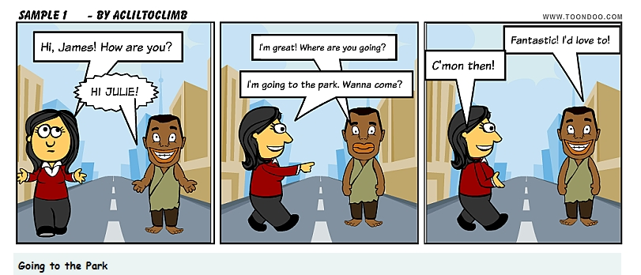
Good dialogue has a purpose
1
Notes:
GOOD DIALOGUE HAS A PURPOSE

Slide 13
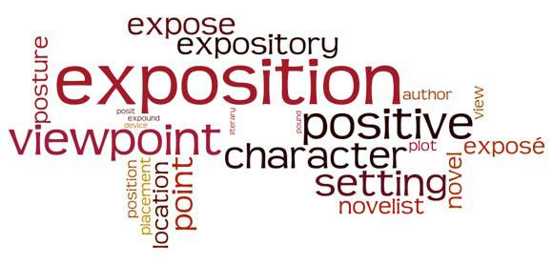
Good dialogue is not weighed down by exposition
2
Notes:
GOOD DIALOGUE IS NOT WEIGHED DOWN BY EXPOSITION

Slide 14

without sounding precisely like the way people talk in real life, Good dialogue evokes the way people actually talk
3
Notes:
WITHOUT SOUNDING PRECISELY LIKE THE WAY PEOPLE TALK IN REAL LIFE, GOOD DIALOGUE EVOKES THE WAY PEOPLE ACTUALLY TALK

Slide 15
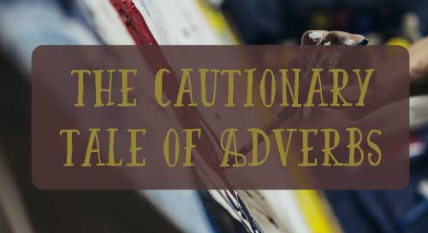
Good dialogue doesn’t use too many ‘ly’ adverbs
4
Notes:
GOOD DIALOGUE DOESN’T USE TOO MANY ‘LY’ ADVERBS

Slide 16
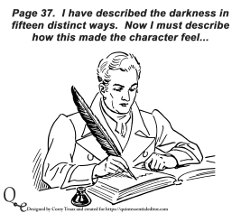
Good dialogue Isn’t redundant
5
Notes:
GOOD DIALOGUE ISN’T REDUNDANT

Slide 17

Good dialogue goes easy on exclamations, exhortations, & aposiopesis
6
Notes:
GOOD DIALOGUE GOES EASY ON EXCLAMATIONS, EXHORTATIONS, & APOSIOPESIS

Slide 18
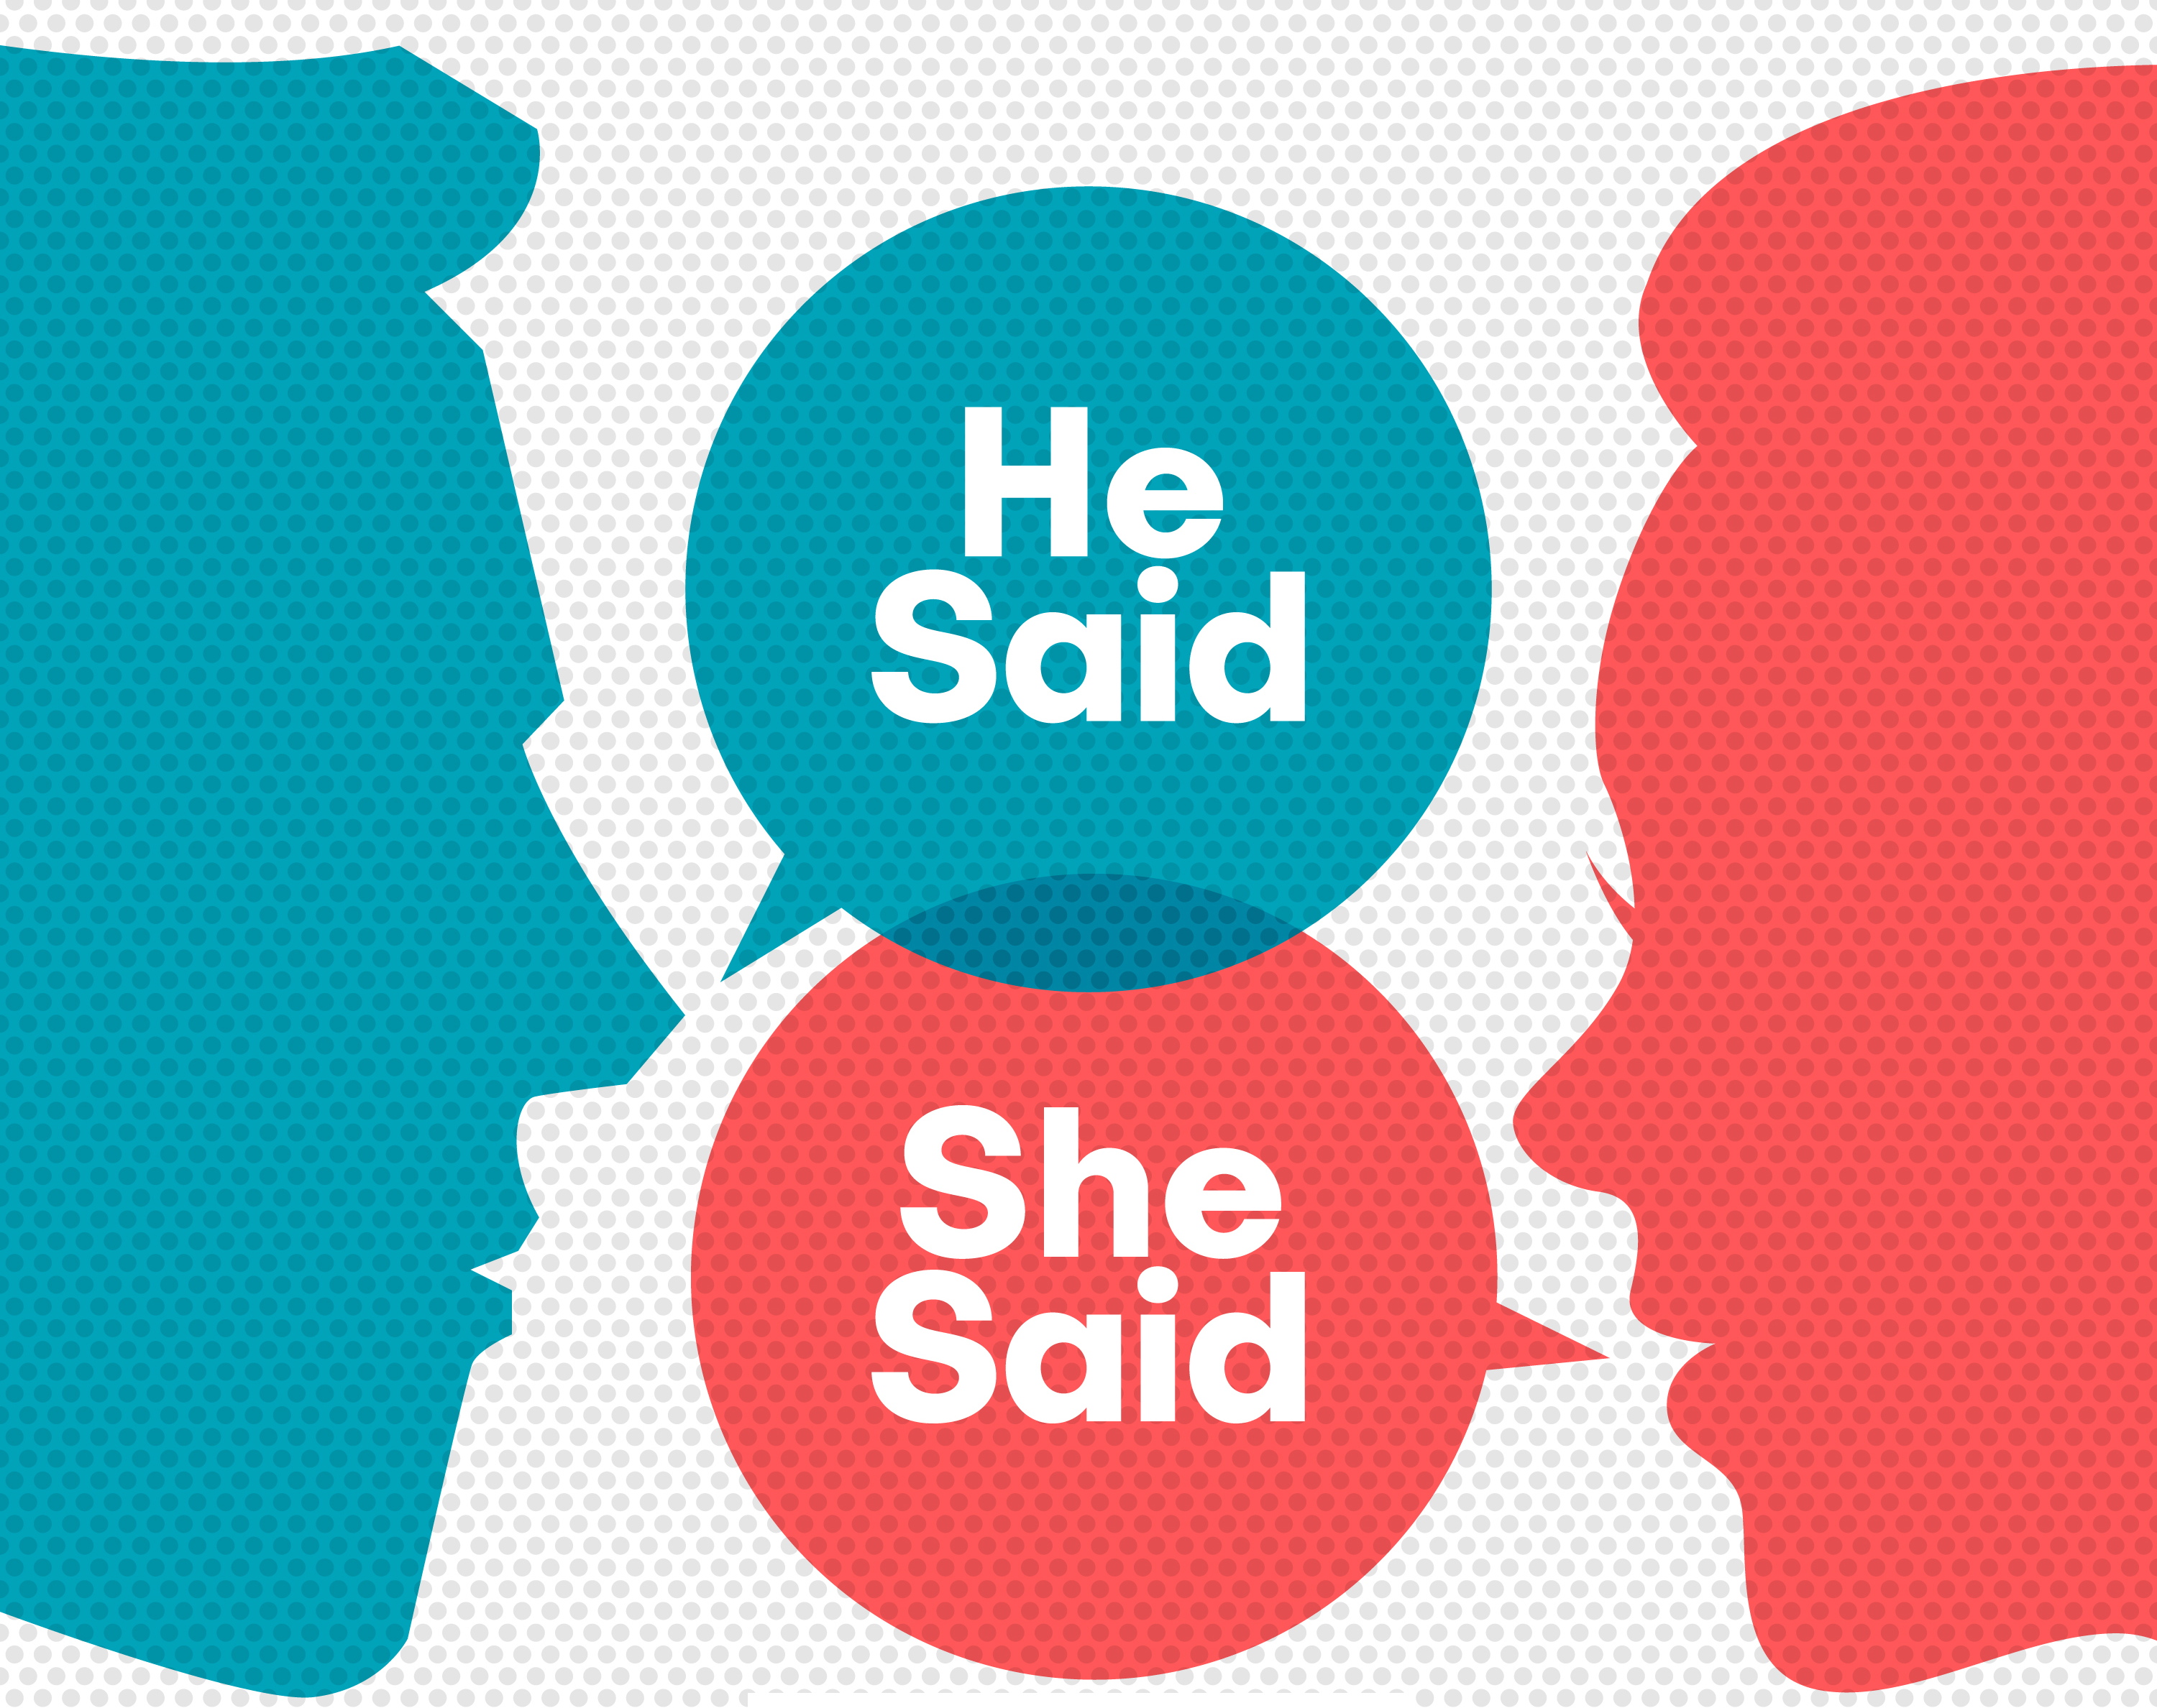

Good dialogue is boosted by dialogue tags, gestures, and action, so the reader can easily follow who is saying what
7
Notes:
GOOD DIALOGUE IS BOOSTED BY DIALOGUE TAGS, GESTURES, AND ACTION, SO THE READER CAN EASILY FOLLOW WHO IS SAYING WHAT

Slide 19

Good dialogue is boosted by dialogue tags, gestures, and action, so the reader can easily follow who is saying what
You may not like this, but truth be told, the verbs said—or asked in the case of an interrogative—should really be your “go-to” verb when writing dialogue.
Said and asked are unusual words primarily because we interpret them in a very mechanical way. In fact, when we see either of these words, we mentally gloss over them as if they represented no more than a comma or a full stop.
BUT you don’t want to use it every single time. In a lot of submissions, I review I tend to find things like this:
“blah, blah,” he said.
“blah, blah,” she said.
“blah, blah,” he said.
“blah, blah.” she said.
“blah, blah,” he said.
“blah, blah?” she said.
Notes:
BUT you don’t want to use it every single time. In a lot of submissions, I review I tend to find things like this:
Not so good dialogue:
“blah, blah,” he said.
“blah, blah,” she said.
“blah, blah,” he said.
“blah, blah.” she said.
“blah, blah,” he said.
“blah, blah?” she said.

Slide 20
Good dialogue is boosted by dialogue tags, gestures, and action, so the reader can easily follow who is saying what
However, there are a ton of words you can use in place of SAID. The next 2 slides contain nearly 600 of them…
… and this file is available to you as a spreadsheet.
http://SuccessfulChristianSelfPublishing.com/MoreThanBW/
Notes:
However, there are a ton of words you can use in place of SAID. The next 2 slides contain nearly 600 of them and this file is available to you as a spreadsheet.

Slide 21
Notes:
A through I

Slide 22
Notes:
J through Z

Slide 23
Good dialogue is boosted by dialogue tags, gestures, and action, so the reader can easily follow who is saying what
Armed with verbs other than said, there may be a temptation to transform the previous example into something like the following:
“blah, blah?” he asked.
“blah, blah,” she replied.
“blah, blah,” he reiterated.
“blah, blah.” she interjected.
“blah, blah?” he queried.
“blah, blah,” she protested.
The obvious problem is that it is equally bad.
Notes:
Armed with verbs other than said, there is a temptation to transform the previous example into something like the following:
Not so good dialogue:
“blah, blah,” he asked.
“blah, blah,” she replied.
“blah, blah,” he reiterated.
“blah, blah.” she interjected.
“blah, blah?” he queried.
“blah, blah,” she protested.
In a misguided effort to avoid “repeating oneself” (redundancy) with said after said after said, the author comes up with a variety of identifying verbs and, let’s be honest, in some cases they don’t even accurately relate to the dialogue.
The obvious problem is that it is equally bad.

Slide 24
Good dialogue is boosted by dialogue tags, gestures, and action, so the reader can easily follow who is saying what
It’s fine to leave off the identifier entirely whenever it’s crystal clear who is speaking.
  “blah, blah?” Boris kept his face perfectly schooled and tried to hide the tension in his neck as he awaited her reply.
  Natasha studied his face, sensing that Boris hid something much bigger behind his casual question. “blah, blah.”
  “blah, blah.”
  She knew something else, something unsaid, lurked behind his deep voice. “blah, blah.”
  “blah, blah.” Boris signaled for the waitress to bring him the bill.
  “blah, blah,” Natasha blurted, regretting it almost immediately.
Look for opportunities to enhance characterization. Color the dialogue with some secret inner thought or emotion. Add some “stage business” like picking up a coffee mug or tapping a fingernail.
Notes:
It’s fine to leave off the identifier entirely whenever it’s crystal clear who is speaking.
“blah, blah.” Boris kept his face perfectly schooled and tried to hide the tension in his neck as he awaited her reply.
“blah, blah.” Natasha studied his face, sensing that Boris hid something much bigger behind his casual question.
“blah, blah.”
“blah, blah.” She knew something else, something unsaid, lurked behind his deep voice.
“blah, blah.” Boris signaled for the waitress to bring him the bill.
“blah, blah,” Natasha blurted, regretting it almost immediately.
Look for opportunities to enhance characterization. Color the dialogue with some secret inner thought or emotion. Add some “stage business” like picking up a coffee mug or tapping a fingernail.

Slide 25

Good dialogue reveals personality, and characters rarely say precisely what they are thinking (Never “on the nose”)
8
Notes:
GOOD DIALOGUE REVEALS PERSONALITY, AND CHARACTERS ONLY VERY RARELY SAY PRECISELY WHAT THEY ARE THINKING

Slide 26

Good dialogue is never “on the nose”
The term “On the nose” can refer to overly expository narrative text, but more often generally refers to unnatural sounding dialogue where the characters say exactly what they think, or where they describe in excruciating detail what they plan to do, somewhat like a ‘60s Bond villain on a monologue.
  When they got in the car, Natasha said, “Boris, I am so mad at you because you always flirt with my sister, Doris, and you know how jealous I get and how competitive I am with her.”
Is this something Natasha would actually say? Sounds pretty unnatural, forced, stilted, etc., doesn’t it? That’s because real people often go to great lengths to NOT say exactly what they’re thinking or feeling. What if Natasha said this to Boris instead?
  When they got in the car, Natasha said, “Remind me the next time we’re at my parents. I think they have a copy of Doris’s prom picture. You can keep it in your wallet.”
Notes:
The term “On the nose” can refer to overly expository narrative text, but more often generally refers to unnatural sounding dialogue where the characters say exactly what they think, or where they describe in excruciating detail what they plan to do, somewhat like a ‘60s Bond villain on a monologue.
Not so good dialogue:
When they got in the car, Natasha said, “Boris, I am so mad at you because you always flirt with my sister, Doris, and you know how jealous I get and how competitive I am with her.”
Is this something Natasha would actually say? Sounds pretty unnatural, forced, stilted, etc., doesn’t it? That’s because real people often go to great lengths to NOT say exactly what they’re thinking or feeling. What if Natasha said this to Boris instead?
Pretty good dialogue:
When they got in the car, Natasha said, “Boris? Remind me the next time we’re at my parents. I think they have a copy of Doris’s prom picture. You can keep it in your wallet.”

Slide 27

Good dialogue is never “on the nose”
The following example is from the late Elmore Leonard. Leonard was known as a master of dialogue.
You would never read one of his books and expect to find something like this farcical example.
In the following scene, two criminals, Bill and Marty, are planning a bank heist. Marty is a two-time loser and a hardened criminal with a penchant for violence. Bill is socially awkward, and rather a weak man, but he is able to open the safe.
Notes:
The following example is from the late Elmore Leonard. Leonard was known as a master of dialogue.
Elmore Leonard’s earliest novels were Westerns published in the ‘50s but he went on to specialize in crime fiction and suspense thrillers. Many of his books and short stories have been adapted into dozens of motion pictures and television shows like Out of Sight, Hombre, Mr. Majestyk, and 3:10 to Yuma as well as the long running FX television series Justified which is set in Kentucky.
You would never read one of his books and expect to find something like this farcical example.
In the following scene, two criminals, Bill and Marty, are planning a bank heist. Marty is a two-time loser and a hardened criminal with a penchant for violence. Bill is socially awkward, and rather a weak man, but he is able to open the safe.

Slide 28
Good dialogue is never “on the nose”
  Bill asked Marty, “But why do we have to be there before lunch? Can’t we just eat lunch then go?
  Marty answered, “Are you actually the dumbest bank robber alive? We have to go there before lunch for three reasons. First, because the vault is on a timer. Second, because the armored car arrives between noon and one so if we go in the afternoon, the vault will be empty. Third, our contact at the alarm company can only disable the alarm for a short amount of time. If we don’t get in and get back out before lunch, we need not even do this!”
As you can see, the answer I supplied for Marty here is very, very on the nose. It is also well out of character for two-time loser and general tough guy, Marty. Elmore actually wrote the dialogue in that scene like this:
  Bill asked Marty, “But why do we have to be there before lunch? Can’t we just eat lunch then go?
  “Shut up,” Marty explained.
Notes:
Not so good dialogue:
Bill asked Marty, “But why do we have to be there before lunch? Can’t we just eat lunch then go?
Marty answered, “Are you actually the dumbest bank robber alive? We have to go there before lunch for three reasons. First, because the vault is on a timer. Second, because the armored car arrives between noon and one so if we go in the afternoon, the vault will be empty. Third, our contact at the alarm company can only disable the alarm for a short amount of time. If we don’t get in and get back out before lunch, we need not even do this!”
As you can see, the answer I supplied for Marty here is very, very on the nose. It is also well out of character for two-time loser and general tough guy, Marty. Elmore actually wrote the dialogue in that scene like this:
Pretty good dialogue:
Bill asked Marty, “But why do we have to be there before lunch? Can’t we just eat lunch then go?
“Shut up,” Marty explained.

Slide 29
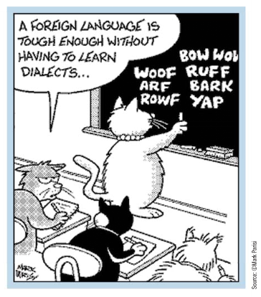
Good dialogue occasionally employs accurate Jargon, Dialect, and drops some words
9
Notes:
GOOD DIALOGUE EMPLOYS JARGON, DIALECT, AND OCCASIONALLY DROPS SOME WORDS

Slide 30

Good dialogue employs Jargon, Dialect, and occasionally drops some words
Occasionally, in real life conversations, people speak with a certain brevity that drops words from one or more sentences.
Instead of:
  “I’m so very sorry, Boris,” Natasha said, “but I simply can’t come over right now.”
A character might say:
  “Sorry, Boris,” Natasha said. “ Can’t make it.”
Notes:
Occasionally, in real life conversations, people speak with a certain brevity that drops words from one or more sentences.
Instead of:
“I’m so very sorry, Boris,” Natasha said, “but I simply can’t come over right now.”
A character might say:
“Sorry, Boris,” Natasha said. “ Can’t make it.”

Slide 31

Good dialogue employs Jargon, Dialect, and occasionally drops some words
Use proper jargon. Sparingly, but accurately, for realism.
Military, Law Enforcement, Pilots, Lawyers, Medical Practitioners, and just about every other profession use lots of jargon and acronyms.
Do your research and use the proper jargon to keep it real.
“Roger, Twelve-Alpha. I read you Five-by-Five.”
A computer specialist is going to employ a ton of technical terms. Research is essential in every case.
A surgeon in an operating room is going to use jargon and speak in acronyms and initialisms. For example, he might (or might not) refer to a femoral head ostectomy as a "feo." He could say distal or proximal to indicate proximity, or the Latin terms dexter or sinister to indicate the left or right and anterior and posterior to indicate the back or front.
Notes:
Use proper jargon. Sparingly, but accurately, for realism.
Military, Law Enforcement, Pilots, Lawyers, and just about every other profession use lots of jargon and acronyms. Do your research and use the proper jargon to keep it real.
“Roger, Twelve-Alpha. I read you Five-by-Five.”
A computer specialist is going to employ a ton of technical terms. Research is essential in every case.
A surgeon in an operating room is going to use jargon and speak in acronyms and initialisms. For example, he might (or might not) refer to a femoral head ostectomy as a "feo." He could say distal or proximal to indicate proximity, or the Latin terms dexter or sinister to indicate the left or right and anterior and posterior to indicate the back or front.

Slide 32

Good dialogue employs Jargon, Dialect, and occasionally drops some words
If your character has an accent or uses dialect, you may wish to reflect that in your dialogue as well. Don’t be afraid to experiment as long as your spelling remains consistent and reads like it sounds.
“Aye, Lass. Thus is a kilt Ahm weerin, an a tartan broach as weel. An wut’n you like ta take a wee keek at mah broadsword, no doubt. Aye. I seen ya haverin.”
But as you can see, it is possible to go overboard.
Notes:
If your character has an accent or uses dialect, you may wish to reflect that in your dialogue as well. Don’t be afraid to experiment as long as your spelling remains consistent and reads like it sounds.
“Aye, Lass. Thus is a kilt Ahm weerin, an a tartan broach as weel. An wut’n you like ta take a wee keek at mah broadsword, no doubt. Aye. I seen ya haverin.”
But as you can see, it is possible to go overboard.

Slide 33

Don’t go overboard with Dialect
Occasionally, in real life conversations, people may use cultural dialectics when speaking English. Attempting to imitate subcultural dialects could be seen as a “racializing” style of stereotype, and offend readers.
Comedian Margaret Cho points to the following common stereotypical speech patterns that you want to avoid:
wrong=wong
right=white
fried rice=flied lice
Eileen=Irene
like=rike
hello=hero
thank you=sank you
I think so=I sink so
Notes:
Occasionally, in real life conversations, people may use cultural dialectics when speaking English. Attempting to imitate this could be seen as a “racializing” style of stereotype.
Comedian Margaret Cho points to the following you probably want to avoid:
wrong=wong
right=white
fried rice=flied lice
Eileen=Irene
like=rike
hello=hero
thank you=sank you
I think so=I sink so

Slide 34
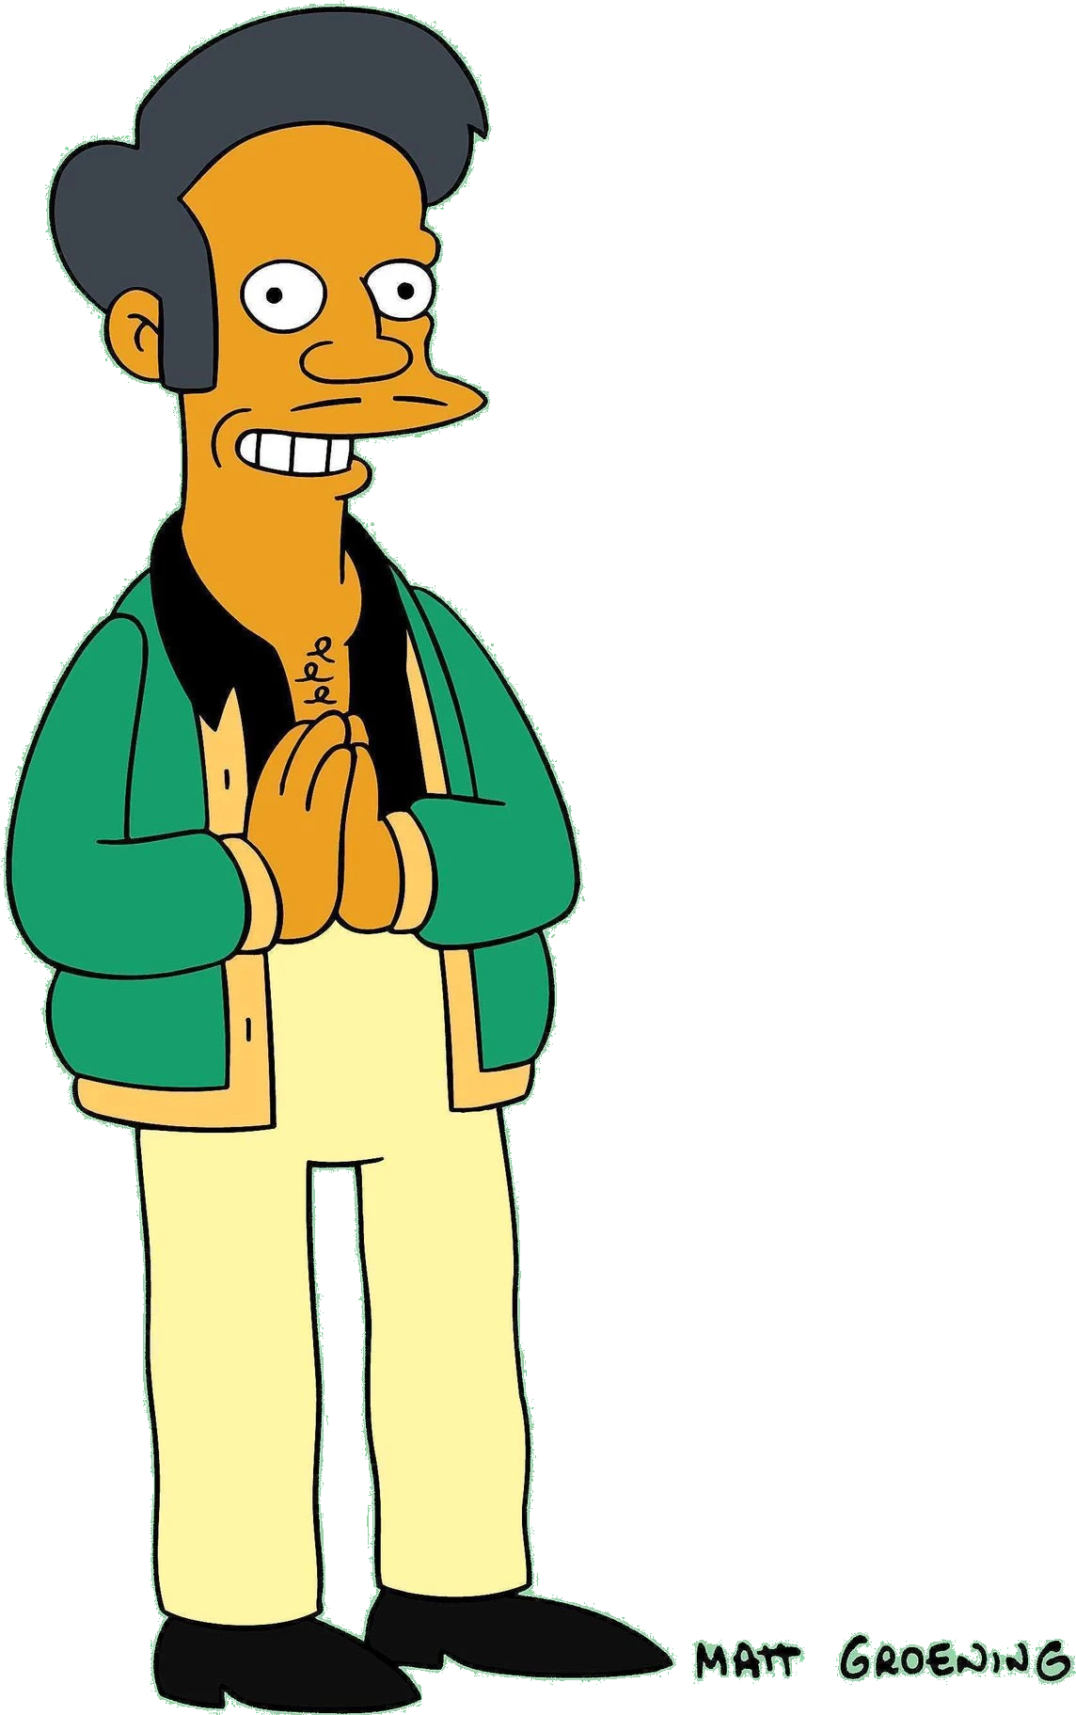
Don’t go overboard with Dialect
In 2018, a comedian produced a documentary entitled “The Problem with Apu” which led to the New York Times publishing a series of editorials pointing out the numerous stereotypes the fictional character on the animated TV series “The Simpsons” perpetuates against people from South Asian descent.
As a result, the show stopped using the character and Hank Azaria stepped down as the voice actor.
The stereotypical dialectic to avoid is swapping out “B” for “P” and speaking very fast with a monotonous cadence.
  Beeble say it’s no broblem.=People say it’s not a problem.
Notes:
In 2018, a comedian produced a documentary entitled “The Problem with Apu” which led to the New York Times publishing a series of editorials pointing out the numerous stereotypes the fictional character on the animated TV series “The Simpsons” perpetuates against people from South Asian descent.
As a result, the show stopped using the character and Hank Azaria stepped down as the voice actor.
The stereotypical dialectic to avoid is swapping out “B” for “P” and speaking very fast with a monotonous cadence.
Beeble say it’s no broblem.=People say it’s not a problem.

Slide 35

Don’t go overboard with Dialect
Comedian Steve Harvey has a famous routine where he riffs on Ebonics which encompasses a specific dialect of American English. Many sources can point to stereotypical dialect you want to avoid:
  She BIN hadat han’-made dress.
  =She’s had that hand-made dress for a long time, and still does.
  Ah own no wut homey be doin.
  =I don’t know what my friend is usually doing.
  Ah ax Ruf cud she bring it ovah to Tom crib.
  =I asked Ruth if/whether she could bring it over to Tom’s place.
  (*Source: Hamilton University—What is Ebonics?)
Notes:
Comedian Steve Harvey has a famous routine where he riffs on Ebonics which encompasses a specific dialect of American English. Many sources can point to stereotypical dialect you want to avoid:
She BIN hadat han’-made dress.
=She’s had that hand-made dress for a long time, and still does.
Ah own no wut homey be doin.
=I don’t know what my friend is usually doing.
Ah ax Ruf cud she bring it ovah to Tom crib.
=I asked Ruth if/whether she could bring it over to Tom’s place.
(*Source: Hamilton University—What is Ebonics?)

Slide 36

Good dialogue sounds unique for every character
10
Notes:
GOOD DIALOGUE SOUNDS UNIQUE FOR EVERY CHARACTER

Slide 37









Good dialogue sounds unique for every character
Every character has to have his or her own voice complete with his or her own preferred speech pattern, rhythm, and dialect.
Otherwise, all of your characters are going to sound like just one person.
Notes:
Every character has to have his or her own voice complete with his or her own preferred speech pattern, rhythm, and dialect.
Otherwise, all of your characters are going to sound like just one person.

Slide 38
Agenda (Three Acts)
I. Characteristics of Good Dialogue
II. He Said / She Said
III. Techniques for Super Realistic dialogue
Notes:
Agenda (Three Acts)
I. Characteristics of Good Dialogue
II. He Said / She Said
III. Techniques for Super Realistic dialogue

Slide 39

He Said / She Said
II.
The Key to Super Realistic Dialogue
http://SuccessfulChristianSelfPublishing.com/MoreThanBW/
Notes:
Act II: HE SAID / SHE SAID
The key to super realistic dialogue

Slide 40


HE and SHE each SPEAK differently
There are fundamental differences between men and women and you can accurately depict these differences in your dialogue (and the narrative).
SHE tends to speak very passively at all times to either sex.
HE tends to speak more actively to men and somewhat less actively to women.
SHE seeks consensus, agreement, validation and without ownership.
HE makes individual choices and with ownership.
Notes:
There are fundamental differences between men and women and you can accurately depict these differences in your dialogue (and the narrative).
SHE tends to speak very passively at all times to either sex.
HE tends to speak more actively to men and somewhat less actively to women.
SHE seeks consensus, agreement, validation and without ownership.
HE makes individual choices and with ownership.

Slide 41










HE speaks much more actively and with ownership
I did this. I fought that.
I grilled this or that.
I killed something.
She cooked the thing I killed yesterday.
I caught something else.
I’ll go do that tomorrow.
I made some money. He ran a 10k.
I hit bad traffic on the way in.
You should to do this or that.
He ought to know better.
I showed her how to do it twice already.
How much should we make/take/bring?
NOTE: Active verbs, pronoun “I”, and ownership
Notes:
HE speaks much more actively and with ownership
I did this. I fought that. I grilled this or that.
I killed something. She cooked the thing I killed yesterday.
I caught something else. I’ll go do that tomorrow.
I made some money. He ran a 10k.
I hit bad traffic on the way in.
You should to do this or that. He ought to know better.
I showed her how to do it twice already.
How much should we make/take/bring?

Slide 42

SHE speaks more passively
I was thinking about what you said.
Seemed like he was enjoying our conversation.
He is such a good boy.
She is so pretty.
My hair is not cooperating today.
Traffic was really bad and made me late.
Someone should do this or that.
I was starving. That was a really good meal.
She was talking about that last week.
He is going to be trouble.
NOTE: Passive verbs (Is Are Was Were Be Being Been), weak descriptors (Seem Seems Seemed Seemingly), and no ownership
Notes:
SHE speaks more passively
I was thinking about what you said.
Seemed like he was enjoying our conversation.
He is such a good boy.
She is so pretty.
My hair is not cooperating today.
Traffic was really bad and made me late.
Someone should do this or that.
I was starving. That was a really good meal.
She was talking about that last week.
He is going to be trouble.

Slide 43


HE and SHE each SPEAK differently
HE is typically the captain of every event HE experiences in life.
One of HIS favorite short words is probably the pronoun “I.”
SHE tends to speak passively because, generally, SHE rarely describes any event as if SHE has any personal stake in that event when it is the case that the event has little to do with a relationship.
Notes:
HE is typically the captain of every event HE experiences in life.
One of HIS favorite short words is probably the pronoun “I.”
SHE tends to speak passively because, generally, SHE rarely describes any event as if SHE has any personal stake in that event when it is the case that the event has little to do with a relationship.

Slide 44

There are exceptions when HE speaks…
Familial relationship matters are often passive, for example. “I was thinking of my sister.” “My wife was amazing giving birth to my son.”
NOTE: This allows the person who he feels deserves all the credit to actively claim all the credit for the accomplishment.
However, if it doesn’t involve a very close relationship, then men generally tend to describe events very actively and as if they were personally involved in whatever transpired.
Notes:
There are exceptions when HE speaks…
Familial relationship matters are often passive, for example. “I was thinking of my sister.” “My wife was amazing giving birth to my son.”
NOTE: This allows the person who he feels deserves all the credit to actively claim all the credit for the accomplishment.
However, if it doesn’t involve a very close relationship, then men generally tend to describe events very actively and as if they were personally involved in whatever transpired.

Slide 45


There are exceptions when SHE speaks…
Familial relationship matters are often active, for example. “I called my sister. I gave birth to my son.”
NOTE: This is because she feels directly and actively responsible for the quality of that relationship.
However, if it doesn’t involve a relationship then women generally tend to speak very passively and as if they were not personally involved in what transpired.
Notes:
There are exceptions when SHE speaks…
Familial relationship matters are often active, for example. “I called my sister. I gave birth to my son.”
NOTE: This is because she feels directly and actively responsible for the quality of that relationship.
However, if it doesn’t involve a relationship then women generally tend to speak very passively and as if they were not personally involved in what transpired.

Slide 46


Why Speak at All?
He believes all communication should have a clear purpose.
Behind every conversation is a problem that needs solving or a point that needs to be made. He uses communication to get to the root of the dilemma as efficiently as possible.
She uses communication to discover how she feels and what she wants to say.
She sees conversation as an act of sharing and an opportunity to increase intimacy with her partner. Through sharing, she releases negative feelings and solidifies her bond with the man she loves or strengthens relationships with friends and loved ones.
Notes:
Why speak at all?
He believes communication should have a clear purpose.
Behind every conversation is a problem that needs solving or a point that needs to be made. Communication is used to get to the root of the dilemma as efficiently as possible.
She uses communication to discover how she feels and what she wants to say.
She sees conversation as an act of sharing and an opportunity to increase intimacy with her partner. Through sharing, she releases negative feelings and solidifies her bond with the man she loves or strengthens relationships with friends and loved ones.

Slide 47

What's the Point?
SHE uses communication to explore and organize her thoughts — to discover the point of the story.
SHE isn’t necessarily searching for a solution when she initiates a conversation. SHE’S looking for someone to listen and understand what she’s feeling. SHE may not know what information is necessary or excessive until the words come spilling out.
HE prioritizes productivity, economy, and efficiency in his daily life, and conversation is no exception.
When HE tells a story he has already sorted through the details in his own head, and shares only those details that he deems essential to the point of the story. HE might wonder, “Why do women need to talk as much as they do?” Often, HE may even interrupt a woman once he has heard the point, or offer a solution.
Notes:
—SHE uses communication to explore and organize her thoughts — to discover the point of the story.
SHE isn’t necessarily searching for a solution when she initiates a conversation.
SHE’S looking for someone to listen and understand what she’s feeling.
SHE may not know what information is necessary or excessive until the words come spilling out.
—HE prioritizes productivity, economy, and efficiency in his daily life, and conversation is no exception.
When HE tells a story he has already sorted through the details in his own head, and shares only those details that he deems essential to the point of the story.
HE might wonder, “Why do women need to talk as much as they do?”
Often, HE may even interrupt a woman once he has heard the point, or offer a solution.

Slide 48
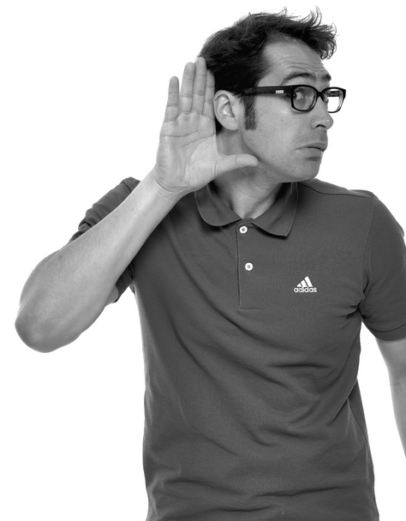
Did you HEAR that?
HE is conditioned to listen actively.
Learning to listen patiently isn’t natural for him. When SHE initiates conversation, HE assumes SHE wants his advice or assistance. HE engages with her, filtering everything SHE says through the lens of, “What can we actually do about this?
SHE sees conversation as a productive end in and of itself.
If SHE feels sufficiently heard or understood, SHE may not need to take further action to resolve a problem or “make things better.” The fact that SHE has been listened to assuages her anxieties and dulls the pangs of negative feelings. Sharing with someone who understands and loves her heals her from the inside and equips her with the emotional tools necessary to handle the trials and tribulations of the outside world.
Notes:
—HE is conditioned to listen actively.
Learning to listen patiently isn’t natural for him. When SHE initiates conversation, HE assumes SHE wants his advice or assistance. HE engages with her, filtering everything SHE says through the lens of, “What can we actually do about this?
—SHE sees conversation as a productive end in and of itself.
If SHE feels sufficiently heard or understood, SHE may not need to take further action to resolve a problem or “make things better.” The fact that SHE has been listened to assuages her anxieties and dulls the pangs of negative feelings. Sharing with someone who understands and loves her heals her from the inside and equips her with the emotional tools necessary to handle the trials and tribulations of the outside world.

Slide 49

HE COPES WITH STRESS differently than SHE does
When HE feels stress or any negative emotion, the very LAST THING that HE wants to do is TALK about his feelings. In fact, talking about his feelings would feel like torture.
Often, when upset or stressed, HE will withdraw into his “cave” (become quiet and withdrawn). A man’s “cave time” is like a tiny vacation: HE reduces stress by forgetting about his problems and focusing on other things like; watching television, reading the newspaper, or playing video games. In reality, HIS subconscious mind is processing and determining a viable COA (Course of Action) to take to resolve the problem, usually by confronting it head on.
HE will almost always avoid communication with HER during times of duress. If SHE persists with nurturing questions or criticism, HE will usually withdraw even further, feeling that SHE doesn’t trust him to “take care of business” on his own.
If SHE gives him space and lets him process his stress, HE feels understood and respected.
Notes:
HE COPES WITH STRESS differently than SHE does
When HE feels stress or any negative emotion, the very LAST THING that HE wants to do is TALK about his feelings. Talking about his feelings would feel like torture.
Often, when upset or stressed, HE will withdraw into his “cave” (become quiet and withdrawn). A man’s “cave time” is like a tiny vacation: HE reduces stress by forgetting about his problems and focusing on other things like; watching television, reading the newspaper, or playing video games. In reality, HIS subconscious mind is processing and determining a viable COA (Course of Action) to take to resolve the problem, usually by confronting it head on.
HE will almost always avoid communication with HER during times of duress. If SHE persists with nurturing questions or criticism, HE will usually withdraw even further, feeling that SHE doesn’t trust him to “take care of business” on his own.
If SHE gives him space and lets him process his stress, HE feels understood and respected.

Slide 50



SHE COPES WITH STRESS differently than HE does
By using words as tools to explore and express her difficult emotions when SHE is upset, SHE is able to process her negative emotions… and let them go.
SHE values support and nurture, and is most fulfilled by sharing, cooperation, and community because this builds or strengthens relationships.
When HE shows interest in HER by asking caring questions or expressing heartfelt concerns, SHE feels loved and cared for because HE is fulfilling her first primary love need.
Notes:
By using words as tools to explore and express her difficult emotions when SHE is upset, SHE is able to process her negative emotions… and let them go.
SHE values support and nurture, and is most fulfilled by sharing, cooperation, and community because this builds or strengthens relationships.
When HE shows interest in HER by asking caring questions or expressing heartfelt concerns, SHE feels loved and cared for because HE is fulfilling her first primary love need.

Slide 51
SHE tends to hint. HE tends to speak with directness.
Does it feel cold in here to you? It feels colder than usual.
It’s cold.
Do you like Mexican or Chinese food? Maybe pizza?
I’m hungry.
What is that you’re watching? Is that something you should be watching do you think? Isn’t there something else?
Turn that off.
SHE tends to seek group consensus.
This means SHE often drops hints hoping someone else may interject and validate her observations.
HE tends to make individual choices.
This means HE is often very direct in his individual observations.
Notes:
SHE: Does it feel cold in here to you? It feels colder than usual.
HE: It’s cold.
SHE: Do you like Mexican or Chinese food? Maybe pizza?
HE: I’m hungry.
SHE: What is that you’re watching? Is that something you should be watching do you think? Isn’t there something else?
HE: Turn that off.
SHE tends to seek group consensus. This means SHE often drops hints hoping someone else may interject and validate her observations.
HE tends to make individual choices. This means HE is often very direct in his individual observations.

Slide 52
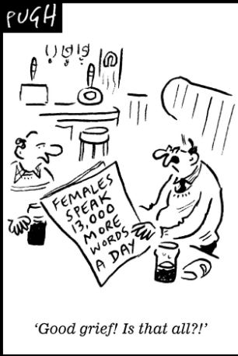
SHE uses a LOT more words per day than HE does
Turns out women do talk more than men, but only a few thousand words per day on average. (4/5/2007 University of Texas at Austin)
Research has shown that women talk almost three times as much as men. In addition, women generally speak more quickly and devote more brainpower to speaking. (2/20/2013 Science World Report)
Previous research by Louann Brizendine at the University of California found that women speak an average of 20,000 words daily compared to only 7,000 words for men. This means that on average, women talk nearly three times as much as men. (2/22/2013 U Penn)
Notes:
SHE uses a LOT more words per day than HE does
These are citations from 3 different studies.
All of these studies concluded SHE speaks anywhere from 2,000 to 20,000 words per DAY more than HE speaks.

Slide 53



























Sometimes HE doesn’t speak at all
Men tend to use far fewer words than women on a daily basis
According to various studies, men speak anywhere from 2,000 to 8,000 to 13,000 fewer words per day than women!
Men tend to stick to the minimum required facts and/or explain events in logical order—when forced to speak at all—and rarely relate events in chronological order.
For women, events that bear little relevance to any personal relationship tend to “just happen” to them and are described in a chronological and linear fashion.
Notes:
Men tend to use far fewer words than women on a daily basis
According to various studies, men speak anywhere from 2,000 to 8,000 to 13,000 fewer words per day than women!
Men tend to stick to the minimum required facts and/or explain events in logical order—when forced to speak at all—and rarely relate events in chronological order.
For women, events that bear little relevance to any personal relationship tend to “just happen” to them and are described in a chronological and linear fashion.

Slide 54
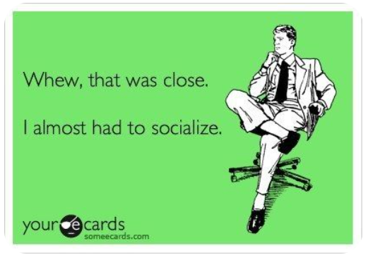
Generally Speaking, Women Like to Socialize and Men Do Not
Notes:
Generally Speaking, Women Like to Socialize and Men Do Not
CARTOON: Whew, that was close. I almost had to socialize.

Slide 55
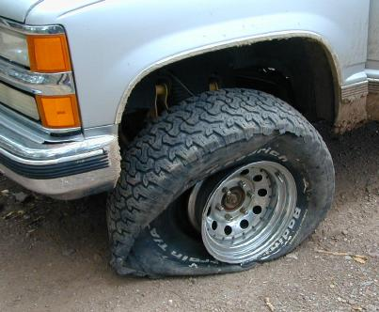
The Flat Tire Example
A lone human being drives a truck down a hill, runs over something sharp, and this is the end result.
Notes:
A lone human being drives a truck down a hill, runs over something sharp, and a flat tire is the end result.

Slide 56

Flat Tire HE SAID
I blew a tire when I ran over something sharp
driving my truck down that hill.
All very active (blew, ran, driving) and factual but not chronologically ordered.
The tire blowing event, which he considers the most significant event, appears in his dialogue before the actual running over the sharp thing, or even the driving down the hill.
This is not in chronological order. He clearly had to be driving down the hill first, run over the sharp thing next, then get the flat tire last.
Notes:
I blew a tire when I ran over something sharp driving my truck down that hill.
OR
I blew a tire this morning.
Active. Not in chronological order.
The tire blowing event, which he considers the most significant event, appears in his dialogue before the actual running over the sharp thing, or even the driving down the hill.

Slide 57

Flat Tire SHE SAID
I was coming down that hill in the truck and then there must have been something sharp in the road because now the tire is flat.
All very passive (was, been, is) and chronologically ordered, but not entirely factual.
In her dialogue, even though she was actually driving the truck, her phrasing could lead one to believe she was merely a passenger in the truck.
Note that events are described in exact chronological order and stated using “to be” verbs instead of active verbs: WAS, BEEN, IS.
Notes:
I was coming down that hill in the truck and then there must have been something sharp in the road because now the tire is flat.
All very passive (was, been, is) and chronologically ordered, but not entirely factual.
In her dialogue, even though she was actually driving the truck, her phrasing could lead one to believe she was merely a passenger in the truck.
Note that events are described in exact chronological order and stated using “to be” verbs instead of active verbs: WAS, BEEN, IS.

Slide 58

The NEW HOUSE EXAMPLE
PROBLEM! A married couple has outgrown their house and they need to buy a larger home.
Notes:
The NEW HOUSE EXAMPLE
PROBLEM! A married couple has outgrown their house and they need to buy a larger home.

Slide 59
New House SHE SAID
Wouldn’t it be great if there were a nice, quiet little house in the suburbs for sale? A house in a good school district with low property taxes?
There are neighborhoods with community pools and playgrounds for the kids.
Maybe there’s a place with a basement for the quilting supplies and a nice kitchen. Oh, and a garage for your tools and your workbench.
And a nice yard with room for a flowerbed and maybe a little victory garden out back. If we get a few acres, we could put in some fruit trees.
Wouldn’t that be great?
Wordcount=94 Sentences=7
Active verbs=2 “to be” verbs=4
Notes:
SHE says:
Wouldn’t it be great if there were a nice, quiet little house in the suburbs for sale? A house in a good school district with low property taxes?
There are neighborhoods with community pools and playgrounds for the kids.
Maybe there’s a place with a basement for the quilting supplies and a nice kitchen. Oh, and a garage for your tools and your workbench.
And a nice yard with room for a flowerbed and maybe a little victory garden out back. If we get a few acres, we could put in some fruit trees.
Wouldn’t that be great?
Wordcount=94
Sentences=7
Active verbs=2
“to be” verbs=4

Slide 60
New House HE SAID
I should probably buy us a bigger house.
Wordcount=8 Sentences=1
Active verbs=1 (100%) “to be” verbs=0
Notes:
HE says:
I should probably buy us a bigger house.
Wordcount=8
Sentences=1
Active verbs=1 (100%)
“to be” verbs=0

Slide 61
New House HE said/SHE said
Wordcount=94 Sentences=7
Active verbs=2 (33.33%)
“to be” verbs=4 (66.66%)
Wordcount=8 Sentences=1
Active verbs=1 (100.00%)
“to be” verbs=0 (0.00%
Notes:
HER Stats:
Wordcount=94
Sentences=7
Active verbs=2
“to be” verbs=4
HIS Stats:
Wordcount=8
Sentences=1
Active verbs=1 (100%)
“to be” verbs=0

Slide 62
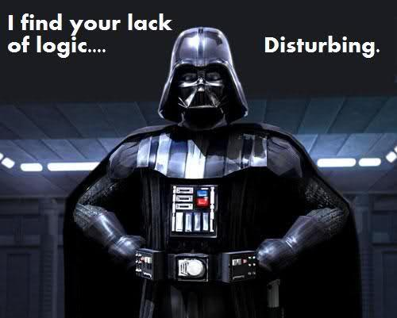
Translating HE Said
Generally speaking, HE will:
  use fewer words than SHE will
  more active verbs
  describe events factually or logically,
  List events by what they perceive as significant events first,
  own whatever happened
The most significant incident—like the flat tire—is worth describing and prioritizing. Likely, HE perceives the other details as mundane and nearly irrelevant.
When HE identifies a problem (like the house is too small) and a solution (buy a new house) then that is LOGICALLY the end of the matter. Problem solved!
Notes:
Generally speaking, HE will:
use fewer words than SHE will
more active verbs
describe events factually or logically,
List events by what they perceive as significant events first,
own whatever happened
The most significant incident—like the flat tire—is worth describing and prioritizing. Likely, HE perceives the other details as mundane and nearly irrelevant.
When HE identifies a problem (like the house is too small) and a solution (buy a new house) then that is LOGICALLY the end of the matter. Problem solved!

Slide 63
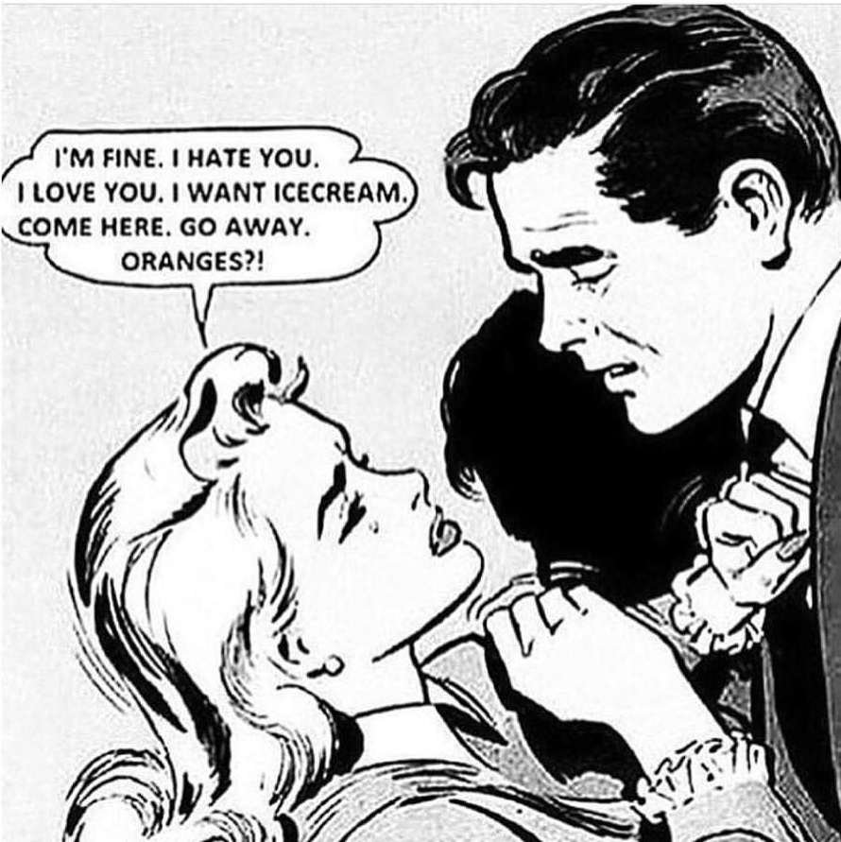
Translating SHE Said
Generally speaking, SHE will
  passively describe the incident using fewer active verbs.
  describe it chronologically as events unfolded
  Describe it as something that just “happened” with little or no ownership of any of the milestones or waypoints
  use more words than their male counterparts
For her, it is more important to understand how the event emotionally affected them, affected a relationship, or was perceived by others.
How SHE anticipates something will make her feel EMOTIONALLY is more important than the something itself. For her, the actual problem and solution are less important than that SHE will feel a certain way once the problem is solved.
Notes:
Generally speaking, SHE will
passively describe the incident using fewer active verbs.
describe it chronologically as events unfolded
Describe it as something that just “happened” with little or no ownership of any of the milestones or waypoints
use more words than their male counterparts
For her, it is more important to understand how the event emotionally affected them, affected a relationship, or was perceived by others.
How SHE anticipates something will make her feel EMOTIONALLY is more important than the something itself. For her, the actual problem and solution are less important than that SHE will feel a certain way once the problem is solved.

Slide 64

INTERROGATION
Questioning, Interviewing, and Lying Liars.
Notes:
Questioning, Interviewing, and Lying Liars.

Slide 65

When HE or SHE is questioned…
The heart of interrogation techniques can
be summed up with the acronym L.E.R.I.
  L-Listen
  E-Empathy
  R-Rapport
  I-Influence
L—Listen to the subject and try to determine the underlying state of mind or emotional state of the subject.
E—Empathize and establish common ground.
R—Establish Rapport by which information can flow freely
I—Influence the subject to disclose vital information and thus achieve your own goals.
Notes:
When HE or SHE is questioned…
The heart of interrogation techniques can be summed up with the acronym L.E.R.I.
L-Listen
E-Empathy
R-Rapport
I-Influence
L—Listen to the subject and try to determine the underlying state of mind or emotional state of the subject.
E—Empathize and establish common ground.
R—Establish Rapport by which information can flow freely
I—Influence the subject to disclose vital information and thus achieve your own goals.

Slide 66
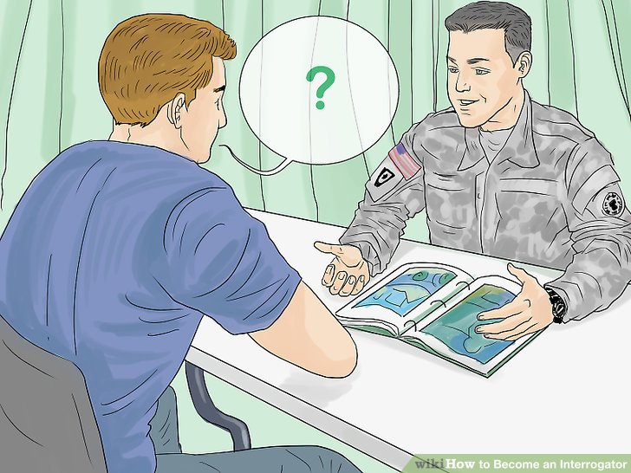
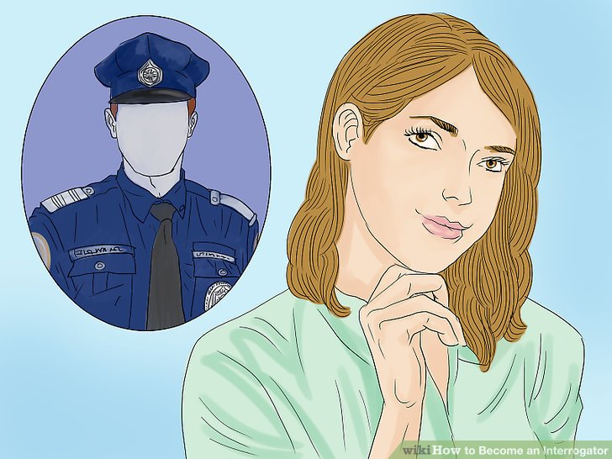
When HE or SHE is questioned…
An effective interrogation technique that law enforcement and trained military interrogators employ is to force any male suspect to review events Chronologically.
An effective interrogation technique employed with women is to force any female suspect to speculate about how significant events made others FEEL while asking about those events out of context with the timeline in which they took place.
Notes:
An effective interrogation technique that law enforcement and trained military interrogators employ is to force any male suspect to review events Chronologically.
An effective interrogation technique employed with women is to force any female suspect to speculate about how significant events made others FEEL while asking about those events out of context with the timeline in which they took place.

Slide 67
When HE or SHE lies
When HE lies, most men are incapable of creating a logically coherent and realistic timeline. Usually, when HE is forced to review events in a linear and chronological way, HE will eventually slip up and leave some gap or create an impossible overlap in time.
This is why interrogators will often “Take it from the top.”
When SHE lies, SHE often cannot appropriately ascribe emotional depth to events or incidents when those events are taken out of chronological sequence.
This is why interrogators will often ask, “How do you think that made ____ feel when that happened?”
Notes:
When HE lies, most men are incapable of creating a logically coherent and realistic timeline. Usually, when HE is forced to review events in a linear and chronological way, HE will eventually slip up and leave some gap or create an impossible overlap in time.
This is why interrogators will often “Take it from the top.”
When SHE lies, SHE often cannot appropriately ascribe emotional depth to events or incidents when those events are taken out of chronological sequence.
This is why interrogators will often ask, “How do you think that made ____ feel when that happened?”

Slide 68
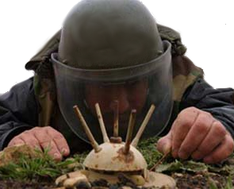
When She Asks Emotionally Charged Questions
Notes:
When She Asks Emotionally Charged Questions

Slide 69
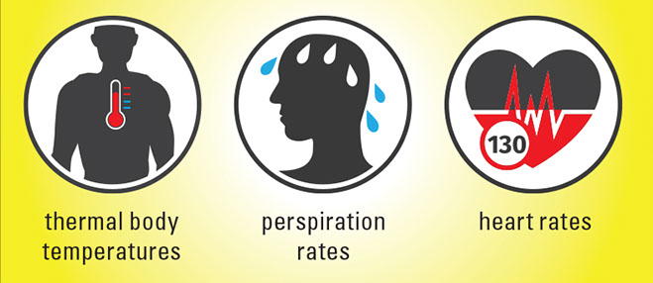
SHE will ask EMOTIONALLY CHARGED questions
SHE tends to ask many more emotionally charged questions than their male counterparts.
HE tends to dodge emotionally charged questions as often as possible and has actual physiological responses when confronting them.
Emotionally charged questions stress HIM out. HE has measurable physical and physiological reactions when confronted with emotions, especially emotions HE considers unreasonable.
Notes:
SHE tends to ask many more emotionally charged questions than their male counterparts.
HE tends to dodge emotionally charged questions as often as possible.
Emotionally charged questions stress men out. They have measurable physical and physiological reactions when confronted with emotions, especially emotions they consider unreasonable.

Slide 70

SHE will ask EMOTIONALLY CHARGED questions
Natasha took a deep breath. “Okay. Here goes. Do you hate commitment? Is calling on the phone so awful? Do you have something against communication? Do you believe in the girlfriend stereotype? Are you actually afraid of settling down? Do you think your life ends when you get married? Do you tell your friends we’re engaged? Do you tell your mom everything? Do you notice when I gain weight? Do you want to dump me? Are you actually unhappy? Do I make you unhappy? Do you ever think about your ex-girlfriend when we’re together?”
Boris frowned, caught her eye, and said, “No.”
Notes:
SHE asks: Natasha took a deep breath. “Okay. Here goes. Do you hate commitment? Is calling on the phone so awful? Do you have something against communication? Do you believe in the girlfriend stereotype? Are you actually afraid of settling down? Do you think your life ends when you get married? Do you tell your friends we’re engaged? Do you tell your mom everything? Do you notice when I gain weight? Do you want to dump me? Are you actually unhappy? Do I make you unhappy? Do you ever think about your ex-girlfriend when we’re together?”
HE responds: Boris frowned, caught her eye, and said, “No.”

Slide 71
Agenda (Three Acts)
I. Characteristics of Good Dialogue
II. He Said / She Said
III. Techniques for Super Realistic dialogue
Notes:
Agenda (Three Acts)
I. Characteristics of Good Dialogue
II. He Said / She Said
III. Techniques for Super Realistic dialogue

Slide 72
Practical Techniques to Craft Super Realistic Dialogue
III.
http://SuccessfulChristianSelfPublishing.com/MoreThanBW/
Notes:
III. Practical Techniques to Craft Super Realistic Dialogue

Slide 73
DIALOGUE REVISION TIPS
Putting it all together
Notes:
We’ll start with some DIALOGUE REVISION TIPS

Slide 74
Given the differences between HE SAID / SHE SAID dialogue
For SHE said:
Depending on the circumstances, female dialogue can be a bit wordy and that’s fine. SHE use thousands or tens of thousands more words per DAY then HE does and rarely feel that a simple “yes or no” answer is the full and complete answer.
For female characters when events “just happen” around them, they are in a “state of being.” So, in the dialogue in those cases, the passive “to be” state of being verbs are perfectly fine.
Actively describe any emotional response to those same events that “passively” happened.
Notes:
Female dialogue can be a bit wordy and that’s fine.
In the dialogue in those cases, the passive “to be” state of being verbs are perfectly fine.
Actively describe any emotional response to those same events that “passively” happened.
For SHE said:
Depending on the circumstances, female dialogue can be a bit wordy and that’s fine. SHE use thousands or tens of thousands more words per DAY then HE does and rarely feel that a simple “yes or no” answer is the full and complete answer.
For female characters when events “just happen” around them, they are in a “state of being.” So, in the dialogue in those cases, the passive “to be” state of being verbs are perfectly fine.
Actively describe any emotional response to those same events that “passively” happened.

Slide 75
Given the differences between HE SAID / SHE SAID dialogue
For HE said:
In the male dialogue, revise a lot of the initial passive “to be” verbs in their speech. When revising male dialogue, generally make it as active as possible.
Give them ownership. “I did this/I said that/I worked to achieve something.”
With most male characters, make his speech just as succinct as possible, nearly to the point of sounding terse. We can steal a page from Elmore Leonard’s playbook, here.
“Shut up,” Marty explained.
That is some good, tight, active, male dialogue.
REMEMBER: There are exceptions. Loving male relatives will speak softly, gently, using passive verbs, and at length with loved ones.
Notes:
In the male dialogue, revise a lot of the initial passive “to be” verbs to make it as active as possible.
Give them ownership. “I did this/I said that/I worked to achieve something.”
With most male characters, make their speech just as succinct as possible.
REMEMBER: There are exceptions. Loving male relatives will speak softly, gently, using passive verbs, and at length with loved ones.
For HE said:
In the male dialogue, revise a lot of the initial passive “to be” verbs in their speech. When revising male dialogue, generally make it as active as possible.
Give them ownership. “I did this/I said that/I worked to achieve something.”
With most male characters, make his speech just as succinct as possible, nearly to the point of sounding terse. We can steal a page from Elmore Leonard’s playbook, here.
“Shut up,” Marty explained.
That is some good, tight, active, male dialogue.
REMEMBER: There are exceptions. Loving male relatives will speak softly, gently, using passive verbs, and at length with loved ones.

Slide 76

Create or Resolve Conflict
Notes:
Create or Resolve Conflict

Slide 77

Conflict: SHE feels SHE isn’t being heard
Have you even heard
a single word I’ve said?
That’s a really strange way to start a conversation.
Notes:
Conflict: SHE feels SHE isn’t being heard
SHE: Have you even heard a single word I’ve said?
HE: That’s a really strange way to start a conversation.

Slide 78

Notes:
This creates conflict.

Slide 79

Conflict Resolution: SHE feels heard
Have you even heard
a single word I’ve said?
Of course I’m listening. I’m trying to understand how you feel about what you’re saying.
Notes:
Conflict Resolution: SHE feels heard
SHE: Have you even heard a single word I’ve said?
HE: Of course I’m listening. I’m trying to understand how you feel about what you’re saying.

Slide 80
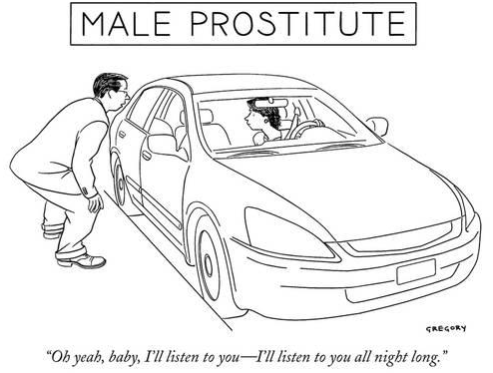
Conflict Resolution: SHE feels SHE is being heard
Notes:
Conflict Resolution: SHE feels SHE is being heard
CARTOON: A “male prostitute” says to a Jane, “Oh, yeah, baby, I’ll listen to you—I’ll listen to you all night long.”

Slide 81

Conflict: HE minimizes how SHE experiences stress/negative emotions
I feel so stressed right now. I have all these negative emotions I am struggling to cope with. Can I just talk about them with you?
Reality check!
You’re making a mountain out of a mole hill.
You’re getting overly emotional about this.
Notes:
Conflict: HE minimizes how SHE experiences stress/negative emotions
SHE: I feel so stressed right now. I have all these negative emotions I am struggling to cope with. Can I just talk about them with you?
HE: Reality check! You’re making a mountain out of a mole hill. You’re getting overly emotional about this.

Slide 82

Notes:
This creates conflict.

Slide 83


Conflict Resolution: HE empathizes with how SHE experiences stress/negative emotions
I feel so stressed right now. I have all these negative emotions I am struggling to cope with. Can I just talk about them with you?
Absolutely.
Let me make you some tea and you tell me how you feel.
Take all the time you need.
I’m here to listen.
Notes:
Conflict Resolution: HE empathizes with how SHE experiences stress/negative emotions
SHE: I feel so stressed right now. I have all these negative emotions I am struggling to cope with. Can I just talk about them with you?
HE: Absolutely. Let me make you some tea and you tell me how you feel. Take all the time you need. I’m here to listen.

Slide 84
Conflict: HE feels interrogated about how HE copes with stress or negative emotions
You’ll feel better if you just tell me how you FEEL right now. Let’s really talk a lot about your feelings.
Leave me alone!
I’m in my CAVE!
Notes:
Conflict: HE feels interrogated about how HE copes with stress or negative emotions
SHE: You’ll feel better if you just tell me how you FEEL right now. Let’s really talk a lot about your feelings.
HE: Leave me alone! I’m in my CAVE!

Slide 85

Notes:
This creates conflict.

Slide 86
Conflict Resolution: SHE gives him space to cope with stress or negative emotions
I can tell you’re stressed. I’m going to give you your space but I’ll be around if you need anything.
Thanks.
Notes:
Conflict Resolution: SHE gives him space to cope with stress or negative emotions
SHE: I can tell you’re stressed. I’m going to give you your space but I’ll be around if you need anything.
HE: Thanks.

Slide 87

Conflict: SHE hears any of the following…
Can we talk?
“Calm down.”
“What is it now?”
“Why do you always do that?”
Notes:
Conflict: SHE hears any of the following…
SHE: Can we talk?
HE: Calm Down. What is it now? Why do you always do that?

Slide 88

Notes:
This creates conflict.

Slide 89

Conflict Resolution: SHE hears something like…
Can we talk?
Of course. Talk to me.
What’s on your mind?
Notes:
Conflict Resolution: SHE hears something like…
SHE: Can we talk?
HE: Of course. Talk to me. What’s on your mind?

Slide 90
Conflict: HE feels disrespected
I just assumed…
That I enjoy disrespect?
Notes:
Conflict: HE feels disrespected
SHE: I just assumed…
HE: That I enjoy distrespect?

Slide 91

Notes:
This creates conflict.

Slide 92

Conflict Resolution: HE feels Respected
I don’t understand why you did/say this but I respect you.
You are amazing!
Notes:
Conflict Resolution: HE feels Respected
SHE: I don’t understand why you did/say this but I respect you.
HE: You are amazing!

Slide 93
Conflict: SHE feels HE won’t “get real” about his feelings
Why won’t you answer me?
Why won’t you return my calls?
Didn’t you get my text message?
…
Notes:
Conflict: SHE feels HE won’t “get real” about his feelings
SHE asks:
Why won’t you answer me?
Why won’t you return my calls?
Didn’t you get my text message?
HE: [nothing]

Slide 94

Notes:
This creates conflict.

Slide 95
Conflict Resolution: HE “gets real” about his feelings
Why won’t you answer me?
Why won’t you return my calls?
Didn’t you get my text message?
This is hard for me to talk about but here goes…
Notes:
Conflict Resolution: HE “gets real” about his feelings
SHE asks:
Why won’t you answer me?
Why won’t you return my calls?
Didn’t you get my text message?
HE: This is hard for me to talk about but here goes…

Slide 96
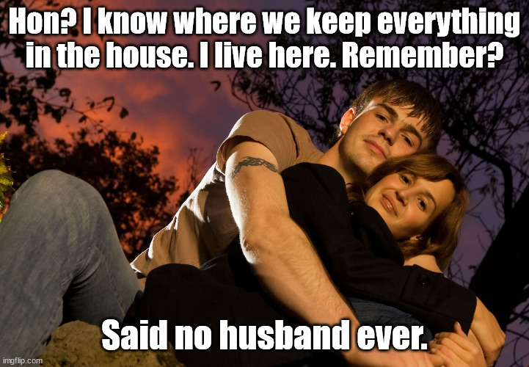
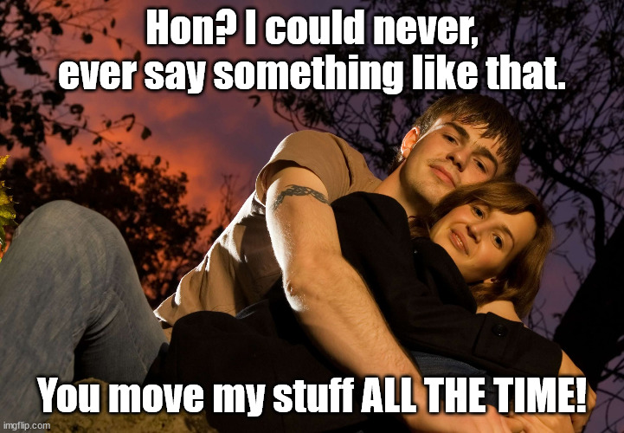
Scenario: True of False?
True.
Notes:
Scenario: QUESTION—True of False.
Hon? I know where we keep everything in the house. I live here, remember?
Said no husband ever.
Scenario: ANSWER—True
Hon? I could never, EVER say something like that.
You move my stuff ALL THE TIME!

Slide 97
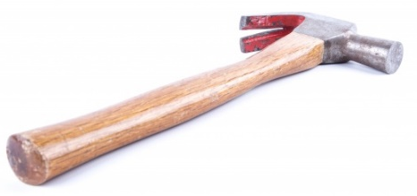
Conflict: SHE will not answer the actual question HE asked
Scenario: HE needs a hammer and some nails to hang a picture.
HE sets the hammer down and goes to retrieve the nails. Upon his return, the hammer is no longer where HE left it. HE is certain he left it there, and that it cannot move itself, and concludes that the most efficient way to get it back is to question the most likely suspect.
Notes:
Conflict: SHE will not answer the actual question HE asked
Scenario: HE needs a hammer and some nails to hang a picture.
HE sets the hammer down and goes to retrieve the nails. Upon his return, the hammer is no longer where HE left it. HE is certain he left it there, and that it cannot move itself, and concludes that the most efficient way to get it back is to question the most likely suspect.

Slide 98
Conflict: SHE will not answer the actual question HE asked
Did you move my hammer?
I left it next to the sink.
Maintenance said they were sending someone tomorrow.
Scenario: HE needs a hammer and some nails to hang a picture.
Notes:
HE asks: Did you move my hammer? I left it next to the sink.
SHE answers: Maintenance said they were sending someone tomorrow.

Slide 99

Ka-Boom!
Notes:
His head literally explodes.

Slide 100


Answer the question that
I asked you!
Why is he so upset?
I’m being helpful.
Men are strange creatures.
Notes:
He is silently begging her to answer the question that he asked her.
She silently wonders why he is upset. In her mind, she is being helpful and this unexpected reaction supports her belief that men are strange creatures.

Slide 101
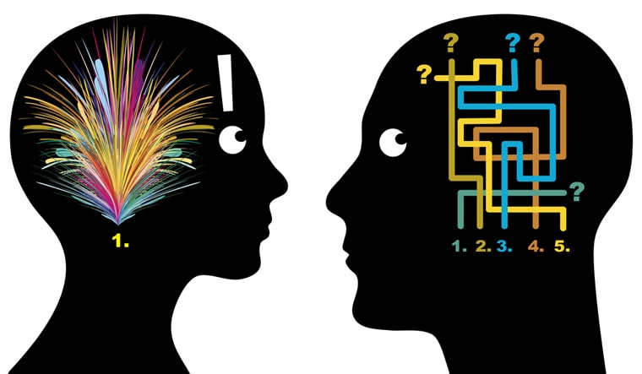
Why didn’t SHE answer his question? Why did HIS head explode?
Notes:
Why didn’t SHE answer his question? Why did HIS head explode?
The answer lies in the way that we think.

Slide 102
Conflict: SHE will not answer the actual question HE asked
Did you move my hammer?
I left it next to the sink.
Maintenance said they were sending someone tomorrow.
SHE interprets the question far differently than HE does.
HE wants and expects a simple, efficient, immediate, correct, and very simple answer to his immediate and actual question.
SHE interprets that HE has some subtext and HE is really asking about some other event, also involving tools, thinks that imaginary scenario through to its conclusion, and answers the question she anticipates HE will eventually ask.
Notes:
SHE interprets the question far differently than HE does.
HE wants a simple, efficient, immediate, correct, and very simple answer to his immediate and actual question.
SHE interprets that HE has some subtext and HE is really asking about some other event, also involving tools, thinks that imaginary scenario through to its conclusion, and answers the question she anticipates HE will eventually ask.

Slide 103
Resolution: SHE answers the question that HE asked
Did you move my hammer?
I left it next to the sink.
Oh. I put it back in your toolbox. I didn’t know you were still using it.
HE will be more ready to move on if the actual question HE asked is addressed.
Having to ask additional questions to arrive at the answer will only magnify HIS stress. HE may even begin to think she is being intentionally obtuse.
Notes:
Resolution: SHE answers the question that HE asked
HE will be more ready to move on if the actual question HE asked is addressed.
Having to ask additional questions to arrive at the answer will only magnify HIS stress. HE may even begin to think she is being intentionally obtuse.
HE asks: Did you move my hammer? I left it next to the sink.
SHE answers: Oh. I put it back in your toolbox. I didn’t know you were still using it.

Slide 104

Resolution: SHE answers the question that HE asked
Never touch my tools.
I’m sorry.
I forgive you. Where’s my hammer?
And they live happily ever after.
Notes:
HE says: Never touch my tools.
SHE says: I’m sorry.
HE says: I forgive you. Where’s my hammer?
And they live happily ever after.

Slide 105
Just a PS
If I say I will do something around the house, I will do it.
Okay.
You don’t need to remind me every six months.
…
Notes:
PS
HE says: If I say I will do something around the house, I will do it.
SHE says: Okay.
HE says: You don’t need to remind me every six months.
SHE says: …..

Slide 106



Conflict: HE can’t get a simple YES or NO (What he expects)
I’m ordering pizza. You want some pizza?
Branch 1: The binary answer is in the affirmative.
Branch 2: The binary answer is in the negative.
Notes:
Conflict: HE can’t get a simple YES or NO (What he expects)
HE asks: I’m ordering pizza. You want some pizza?
He expects one of only two possible binary responses:
Branch 1: The binary answer is in the affirmative.
Branch 2: The binary answer is in the negative.

Slide 107
Branch 1: The binary answer is in the affirmative.
I’m ordering pizza. You want some pizza?
Yes. I’d love some. Thanks.
Notes:
Branch 1: The binary answer is in the affirmative.

Slide 108



Branch 1: The binary answer is in the affirmative. (What he expects)
HE and SHE enjoy yummy pizza together.
Notes:
Branch 1: The binary answer is in the affirmative. (What he expects)
They enjoy yummy pizza together.

Slide 109
Branch 2: The binary answer is in the negative.
I’m ordering pizza. You want some pizza?
No, thanks. Not super hungry just now.
Notes:
Branch 2: The binary answer is in the negative.

Slide 110
Branch 2: The binary answer is in the negative. (What he expects)
HE enjoys yummy pizza by himself, SHE is happy, and life is good.
Notes:
Branch 2: The binary answer is in the negative. (What he expects)
He enjoys yummy pizza by himself and life is good.

Slide 111
Branch 3: The binary answer is unobtainable. (What actually happens)
I’m ordering pizza. You want some pizza?
Where are you ordering from?
Papa John’s.
Okay.
Notes:
Branch 3: The binary answer is unobtainable. (What actually happens)

Slide 112

Notes:
He is holding his forehead to keep his head from exploding.

Slide 113
Branch 3: The binary answer is unobtainable. (What actually happens)
I’m ordering pizza. You want some pizza?
Where are you ordering from?
Papa John’s.
Okay.
Okay, so do you want some pizza?
I said ‘yes’.
No. You didn’t.
Fine. What are you having on yours?
The usual. Do you want some pizza?

Slide 114
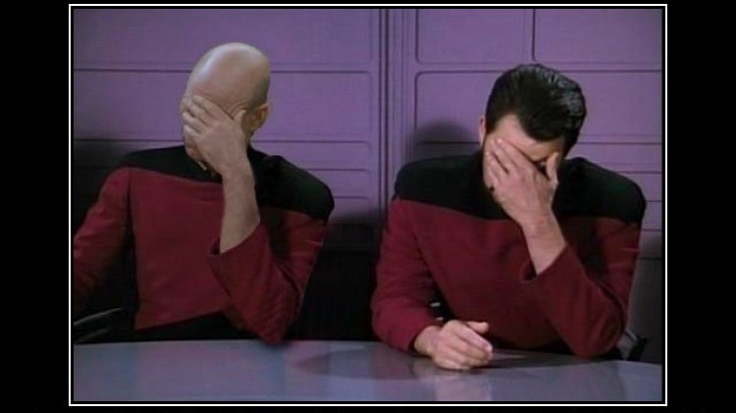
Notes:
He is holding his forehead to keep his head from exploding.
And so is he.

Slide 115
Branch 3: The binary answer is unobtainable. (What actually happens)
I’m ordering pizza. You want some pizza?
Where are you ordering from?
Papa John’s.
Okay.
Okay, so do you want some pizza?
I said ‘yes’.
No. You didn’t.
Fine. What are you having on yours?
The usual. Do you want some pizza?
What do they have?
For pizza? Toppings. Cheese. Meat. Veggies.
DO YOU WANT A PIZZA?
Are you picking it up?
I’m starting to think I should.
Why?
Notes:
What HE does not expect is a branch 3 answer.
Branch 3: The binary answer is unobtainable.
HE: I’m ordering pizza. You want some pizza?
SHE: Where are you ordering from?
HE: Papa John’s.
SHE: Okay.
HE: Okay, so do you want some pizza?
SHE: I said ‘yes’.
HE: No. You didn’t.
SHE: Fine. What are you having on yours?
HE: The usual. Do you want some pizza?
SHE: What do they have?
HE: For pizza? Toppings. Cheese. Meat. Veggies. DO YOU WANT A PIZZA?
SHE: Are you picking it up?
HE: I’m starting to think I should.
SHE: Why?

Slide 116
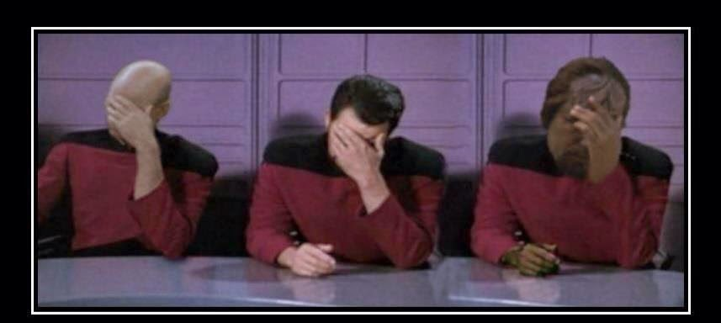
Conflict: HE can’t get a simple YES or NO (What actually happens)
Notes:
He is holding his forehead to keep his head from exploding.
And so is he.
And now, so is he.

Slide 117











Obviously…
The resolution to this conflict is to provide an answer using one of the binary options.
Actual Website…
Notes:
The resolution to this conflict is to provide an answer using one of the binary options.
There are books and websites that can help learn how to answer with a binary response.

Slide 118

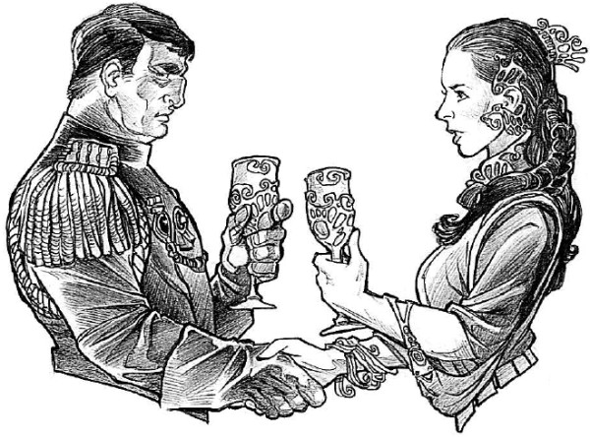
TRUCE!
There is neither Jew nor Greek, there is neither slave nor free, there is neither
male nor female; for you are all one in Christ Jesus.
—Galatians 3:28 (NKJV)
Notes:
Let’s call a TRUCE on this particular battle.
There is neither Jew nor Greek, there is neither slave nor free, there is neither male nor female; for you are all one in Christ Jesus.
—Galatians 3:28 (NKJV)

Slide 119

Eavesdrop.
Really. Go ahead. You’re allowed. It’s called
REASEARCH!
Notes:
Eavesdrop.
Really. Go ahead. You’re allowed. It’s called REASEARCH!
You are SERIOUSLY allowed.

Slide 120

Eavesdrop…
…and keep a close eye out as well
Become a student of conversation
Coffee shops, shopping malls, and restaurants are alive with people talking, laughing and sharing stories.
While away a Saturday morning in a local coffee shop, jotting down conversation topics that are bandied around from table to table.
Unabashedly pay attention to gestures, tones, facial expressions, and reactions as those very snippets from real life can help you write compelling, believable dialogue.
Conversation isn’t merely an exchange of words. Oh no, we also use body language to get our message across, so it goes without saying that this needs to be captured in your dialogue.
Notes:
…and keep a close eye out as well
Become a student of conversation.
Coffee shops, shopping malls, and restaurants are alive with people talking, laughing and sharing stories.
While away a Saturday morning in a local coffee shop, jotting down conversation topics that are bandied around from table to table.
Unabashedly pay attention to gestures, tones, facial expressions, and reactions as those very snippets from real life can help you write compelling, believable dialogue.
Conversation isn’t merely an exchange of words. Oh no, we also use body language to get our message across, so it goes without saying that this needs to be captured in your dialogue.

Slide 121

Act it out
Read it aloud.
Notes:
Read it aloud and act out the scene and the dialogue.

Slide 122

Read it aloud. Act it out.
During the editing process, you should always read your manuscript aloud, and do pay special attention to your dialogue.
If the dialogue doesn’t flow, or you’re tripping over your words, it’s not going to sound right to the reader either.
Even though you’re not capturing every part of a conversation in your dialogue, everything that’s written should sound like an actual person said it. If not, it’s time to erase and try again.
Notes:
During the editing process, you should always read your manuscript aloud, and do pay special attention to your dialogue.
If the dialogue doesn’t flow, or you’re tripping over your words, it’s not going to sound right to the reader either.
Even though you’re not capturing every part of a conversation in your dialogue, everything that’s written should sound like an actual person said it. If not, it’s time to erase and try again.

Slide 123

Read it aloud. Act it out.
Listen for clichés. Listen for overuse or repeated use of any phrases.
Listen to see if each character has a unique voice.
If you’re in a writers’ group, you might even ask other members to read your dialogue aloud
Notes:
Listen for clichés. Listen for overuse or repeated use of any phrases.
Listen to see if each character has a unique voice.
If you’re in a writers’ group, you might even ask other members to read your dialogue aloud

Slide 124
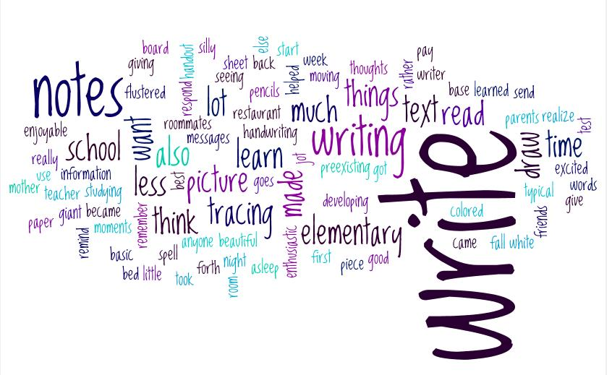
Revise, revise, revise
Notes:
Revise, revise, revise

Slide 125
Revision Can be VERY Important.
(Editor’s note—Please revise this sentence for proper punctation!)
A woman without her man is nothing.
HE punctuates:
A woman, without her man, is nothing.
SHE punctuates:
A woman: without her, man is nothing.
Notes:
(Editor’s note—Please revise this sentence for proper punctation!)
A woman without her man is nothing.
HE punctuates:
A woman, without her man, is nothing.
SHE punctuates:
A woman: without her, man is nothing.

Slide 126

Men are More than Black and White
http://SuccessfulChristianSelfPublishing.com/MoreThanBW/
Notes:
Questions?

Slide 127
Next time:
Part 3: Toss Out Male Tropes
http://SuccessfulChristianSelfPublishing.com/MoreThanBW/

